Slide 1

team X
MPA teamanalys

Slide 2
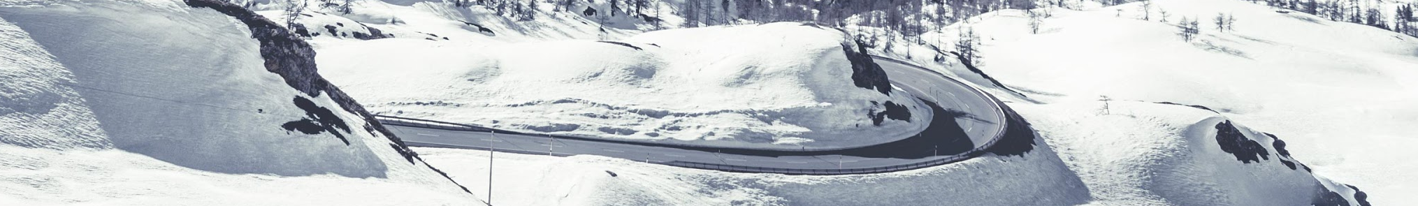
syfte.
  Att belysa teamet utifrån MPA med fokus på beteende och kommunikation och därmed skapa bättre förutsättningar för att kunna bli ett effektivt team som jobbar i enlighet med uppsatta mål. Att bidra till fortsatt utveckling i gruppen genom att medvetandegöra och lyfta fram möjligheter och eventuella utmaningar. Att bättre förstå sin omgivning för att kunna anpassa sin kommunikation i högre grad. Att skapa energi för att fortsätta diskussionen och utvecklingen av teamet.
  Vad tycker du?

Slide 3
vad är ert ‘why’? vart ska ni?

Slide 4
innehåll
introduktion
modellen
beteenden
teamet

Slide 5
etik, konfidentialitet och processkonsultens roll
Notes:
Processkonsulten är ansvarig för att säkerställa konfidentialitet och professionell sekretess i teamanalysen,
att skapa förutsättningar för självreflektion i teamet.
Det finns inga rätt eller fel beteenden och det grafiska resultatet visar inget ”facit”.

Slide 6
vad är ett team?

Slide 7


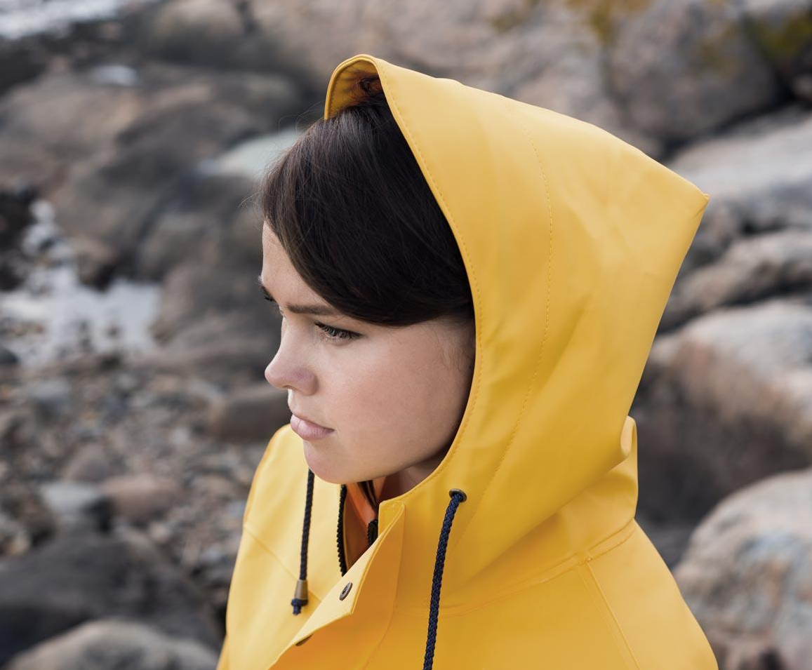
team
01 | arbetar mot gemensamma mål
02 | har olika roller
03 | är ömsesidigt beroende av varandra
04 | måste samarbeta för att åstadkomma resultat
05 | tillsammans skapar en helhet som är större än dess beståndsdelar
är ni ett team?

Slide 8
två nyckelkompetenser
Majoriteten av individer som arbetar i team tar med sig två nyckelkompetenser:
Professionell kunskap/specialistkunskap, kvalifikationer och erfarenhet
Karaktäristiska personliga egenskaper/beteende
Notes:
It is important to distinguish these two key competencies, as both can exert a decisive influence on the efficiency of the team. However, experience has shown that focusing on just one of the 2 competencies, e.g. professional/specialist knowledge and qualifications does not necessarily lead to a successful team. Point 1, however, is often the basis of an employment and wide experience indicates that this is also often the basis for selection to a team project.
Remember that MPA and the team role tool do not measure point 1. This tool allows you to examine competencies under point 2. The tool sets the stage for self-reflection, team-reflection and the development of the individual and the team.

Slide 9
Vad påverkar teamrollens beteende?
Personlighet
Intellektuell
förmåga
Rollinlärning
Teamrolls-
beteende
Värderingar
Erfarenheter
och
attityder
Relation till
omvärlden

Slide 10

personlighet och beteenden
Notes:
Flera lager, vi tittar på det yttersta, som är mätbart.
Vi kommer inte kunna mäta avvikelser t.ex. Psykopati eller sociopati

Slide 11
effektiva team

Slide 12
kännetecken för ett effektivt team
Delaktigt ledarskap
Positiv atmosfär
Samarbetsvilja
Aktivt balanserat deltagande
Uppskattar skillnader
Öppen konflikthantering
Tydliga
mål
Definierade
roller
Öppen och tydlig kommunikation
Effektiva beslutsprocesser
Notes:
Most organisations are subject to many and rapid change processes, which make great demands on the flexibility of individuals and teams if they are to be efficient and survive.
It would therefore be unrealistic to see how there could be a sustainable "recipe" for the efficient team. Instead, based on research and experience one can examine work methods and develop methods that are suited to the changed circumstances. E.g. today, teams are becoming less uniform as a result of changes in working patterns such as part time working, flexible working hours, working from home and cooperation across national borders, etc.
Michael West: As teams become more diverse in their composition and work functions, members must learn to observe and adapt to the changing circumstances - in order to be efficient this is a prerequisite of efficient team work.
Go to OH: The above model (from The Pfeiffer book and Successful Teambuilding Tools) is a model of the characteristics present in successful teams. This model was presented at the Introduction Course. The model is useful in fathoming your team and finding the areas where there may be aspects in need of clarification which are preventing the team functioning optimally. The boxes in the model have not been set up at random. The boxes at the bottom form the foundation of all the others and must be well established at the early stages of the team. Row 2 is also essential in the early stages and entirely depends on the basic foundations (the bottom row) being in place. Row 3 contains characteristics which provide job satisfaction and make it rewarding to be in the team. Experience has shown that the top box - participating leadership - is the only box that can be removed without disturbing the others. This does not mean that leadership and the type of leadership is without influence but that especially in the early stages of the team the leader is not a crucial factor. It can also mean that leadership can be passed around depending on the team's work assignments or the team's "development phases". The model is equally useful in motivating and clarifying how working with team roles, behavioural preferences and differences can contribute to raising team efficiency and cooperation. There are two boxes in the model highlighted in red. These indicate where emphasis is to be placed in the model when working with MPA and the team role model.

Slide 13
Fyra dimensioner av teamarbete
 |  | Resultatorientering
 |  | Hög | Låg
Socialt välbefinnande |  | Typ 1: Fullt funktionellt team Hög resultatorientering Bra socialt välbefinnande Lång livskraftighet | Typ 2: Processorienterat, trivsamt team Dålig resultatorientering Högt socialt väl-befinnande Kort livskraftighet
 |  | Typ 3: Uppgiftsorienterat, kallt team Hög resultatorientering Medel eller dåligt socialt välbefinnande Kort livskraftighet | Typ 4: Dysfunktionellt team Dålig resultatorientering Dåligt socialt väl-befinnande Väldigt låg livskraftighet
Högt
Lågt
Notes:
When the consultant is to ensure motivation for the process and support for the use of the team tool (refer to points on Flip-over No. 5), it may be appropriate to clarify the relationship between the team members' behavioural preferences (= team's typical mode of operation) and team efficiency. Models are useful in this connection.
Re OH) Michael West constructs a practical, useful model for intra-team cooperation. The model can be used to characterise a specific team (the members can also participate in identifying themselves). His model illustrates 4 types of intra-team cooperation and is the most visible influence on the most important outcomes of team cooperation: efficiency in achieving goals, the members' sense of satisfaction and the team's viability.
Michael West proposes 3 main components for team efficiency:
"Task efficiency" is the degree to which the team succeeds in reaching its task-related objectives.
"Mental satisfaction" refers to the team members' sense of well-being, growth and development.
"Team viability" is the likelihood that the team will continue to work together and function efficiently.
Re: fully-functioning teams: open communication about objectives, procedures, duties and intrapersonal satisfaction. Wants the collaboration.
Re: cosy teams: often low satisfaction with the team from the rest of the organisation.
Re: dysfunctional teams: often much internal conflict among team members.
Re: The cold, efficient team: In this case, the members often want to conclude the team inspite of high "task efficiency".
Refer to the Introduction in Michael West’s book, which has an example of how to measure task and social reflexivity.
A short summary of Belbin's "strategies" for a winning team:
A coordinator as team manager
A wide range of intelligence
A wide range of roles
A distribution of member duties which are appropriate to their abilities
Belbin also experienced that less successful teams typically distributed work duties based on what the members had previously worked with without fully considering this.
All research in this area shows that one unforeseen factor (each small change in the group) can ruin an otherwise promising balance in the team:
One person loses interest
A member is absent
A redistribution of duties
A change in procedures
Etc.
It is Utopian to think that there is a guaranteed recipe for building an efficient, cooperative team. It is currently more the rule than the exception that workplace conditions are undergoing rapid change and development. This indicates that individuals, teams and organisations must be flexible if they are to be effective and persist. In order for a team to function efficiently, the members must actively focus on both their goals (the task), their working methods and the team's social interation. A well-functioning and efficient team is consciously aware that a team consists of members with a number of different emotional, social and task-related preferences/needs that the team as whole either is filling or counteracting.

Slide 14
övning 1: reflektion kring teamet
Placera teamet i den ”box” där det hör hemma, baserat på dina erfarenheter kring teamet (individuellt).
Utifrån given information, vad är teamet i störst behov av just nu?

Slide 15
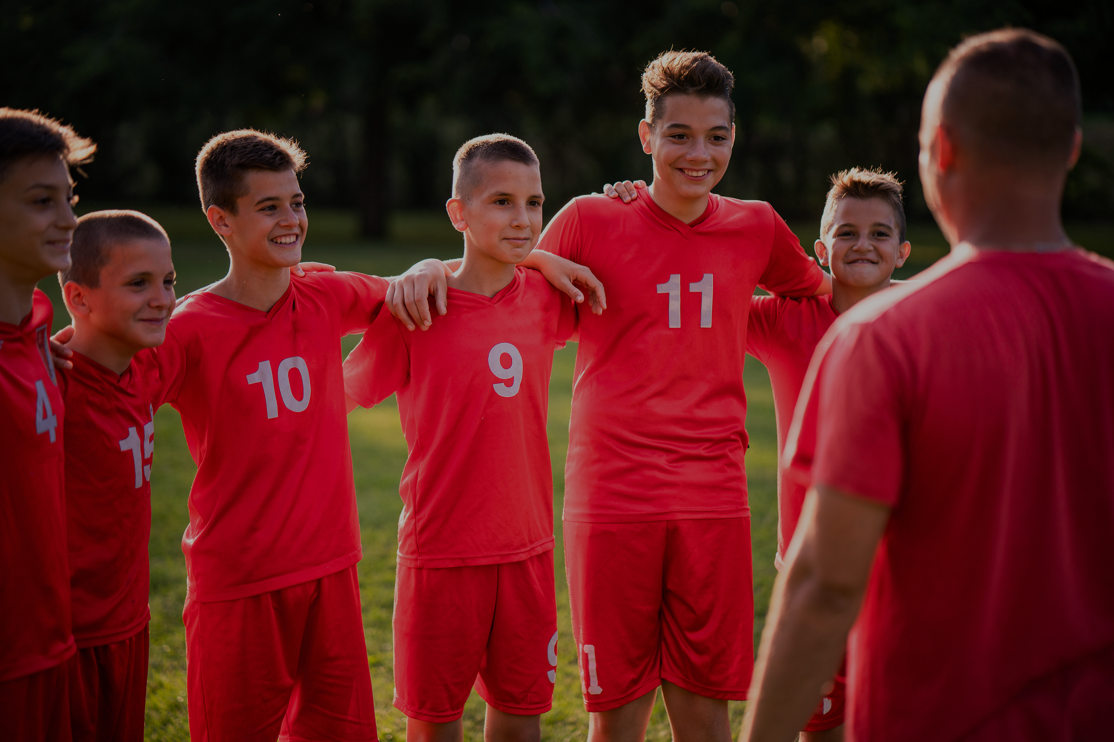
teamanalys
Notes:
Re: OH: The instructor illustrates a presentation of a Master Team Analysis based on the team participants' profiles. This centres on the headings from the list of how one presents the results of a MPA, which was introduced in 'Introduction to Master Team Analysis'.
The purpose of illustrating team feedback is to exemplify how the participant can use the team tool specifically in connection with team development. The illustration has three foci:
1) How can the consultant use the information in a Master Team Analysis to analyse a team in relation to behavioural preferences; typical modes of operation, similarities and differences among team members, team strengths and areas of development?
2) How can the consultant present his/her team analysis to a specific team?
3) How can the consultant use the analysis to formulate working hypotheses about the team?

Slide 16
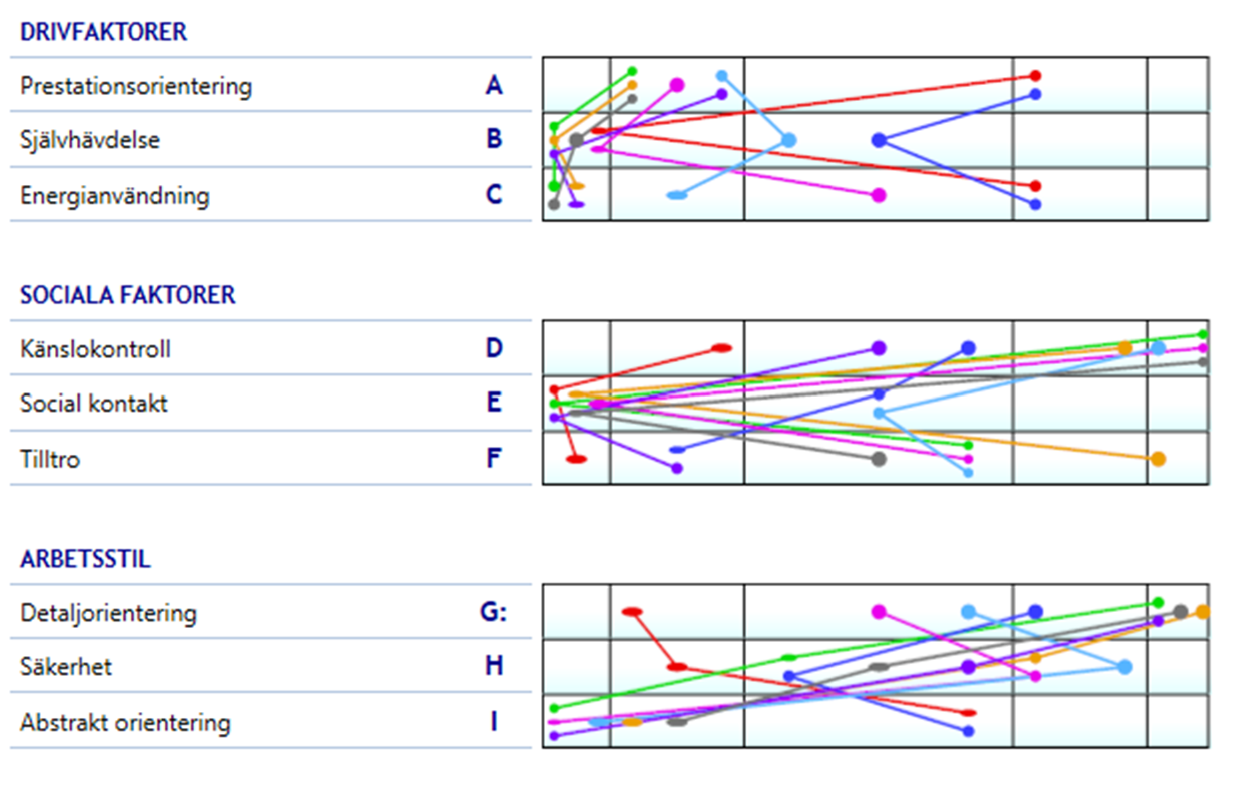
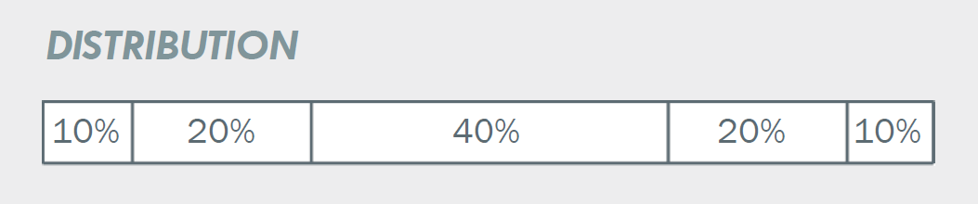
Mindre grad
Högre grad
Teamet

Slide 17
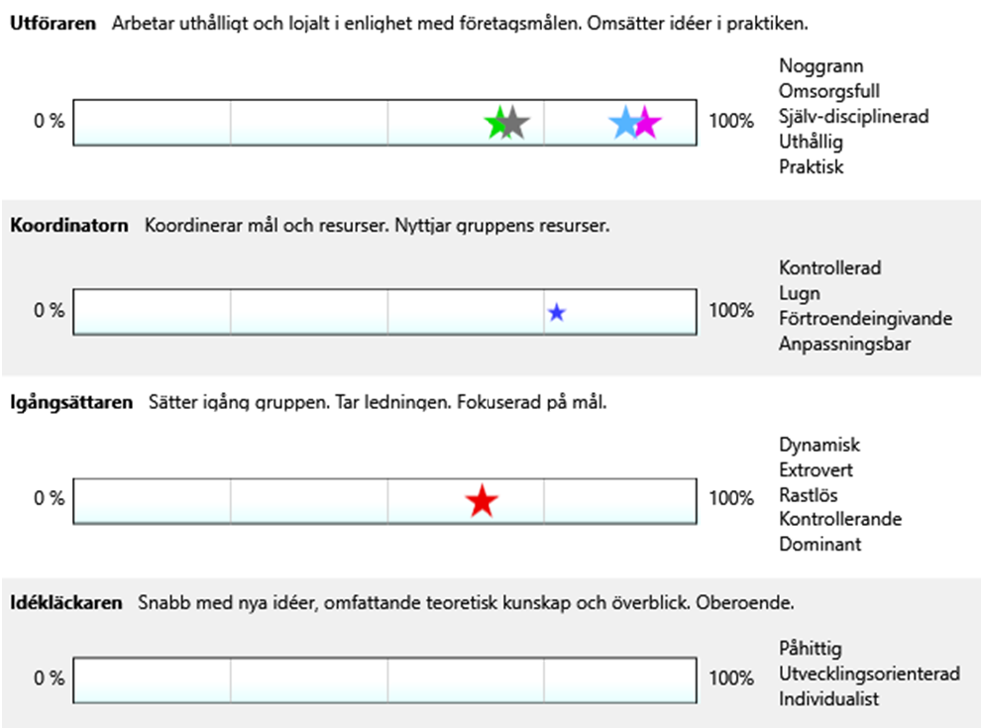
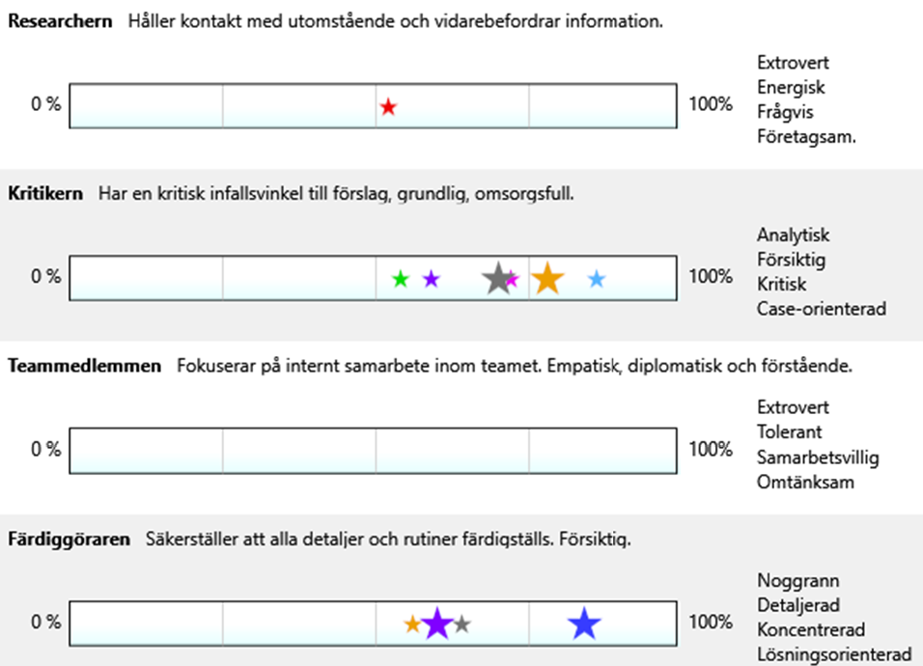
fördelning av teamroller

Slide 18

analys och
hypoteser
om teamet

Slide 19
exempel analys.
Tre teamroller med stort uppgiftsfokus i majoritet
Två teamroller saknar täckning – Teammedlemmen och Idékläckaren
hur ser sammansättningen ut?

Slide 20
exempel: hypoteser.
Processorienterade
Teamet har fokus på processens genomförande och är uthålliga.
Noggranna och detaljfokuserade
Teamet har ett stort fokus på detaljer och levererar med stor noggrannhet.
Säkrar beslut
Teamet tar inga förhastade beslut och säkerställer att de är korrekta.
Analytiska
Teamet har ett analytiskt förhållningssätt och undersöker många infallsvinklar.
Självständigt
Teamet jobbar effektivt i mindre grupper eller självständigt som individer.
teamets styrkor

Slide 21
exempel: hypoteser.
Tillbakadragna
Teamet är tillbakadraget och vill inte gärna ta kommandot i sociala situationer.
Förhindrar utveckling
Teamet kan ha alltför stort detaljfokus vilket kan inverka på projektens leverans eller utvecklingsfokus.
Kritiska
Teamet har kritiska åsikter om förslag på förändring eller utveckling och kan ha svårt att se ”skogen för alla träd”. Kan verka demotiverande för andra personer i organisationen.
Reaktiva
Teamet kan ha svårt att sätta igång och driva egna processer och väntar gärna in andras förslag och aktivitet.
teamets fallgropar

Slide 22

övning - skapa handlingsplan
Diskutera hur ni ställer er till hypoteserna om styrkor/fallgropar.
Vad behöver ni konkret göra som team för att undvika fallgropar?
Vilka regler/riktlinjer ska gälla på kommande möten för att samarbetet och kommunikationen ska fungera?
Gemensam diskussion: När och hur följer ni upp att ni efterföljer dessa regler/värderingar?

Slide 23
tack för idag.
vad är det viktigaste ni som team skapat idag?
när pratar ni om detta nästa gång?

