Slide 1
team analysis
Workshop MPA

Slide 2
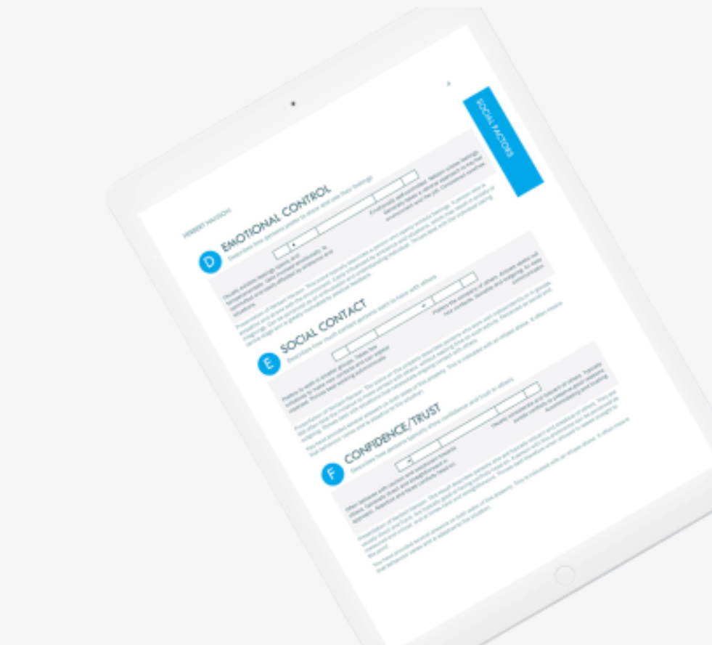

MPA – personality test
MPA is a well-documented personality test that measures nine basic characteristics. MPA includes a team role perspective that can contribute to a team's development.

Slide 3
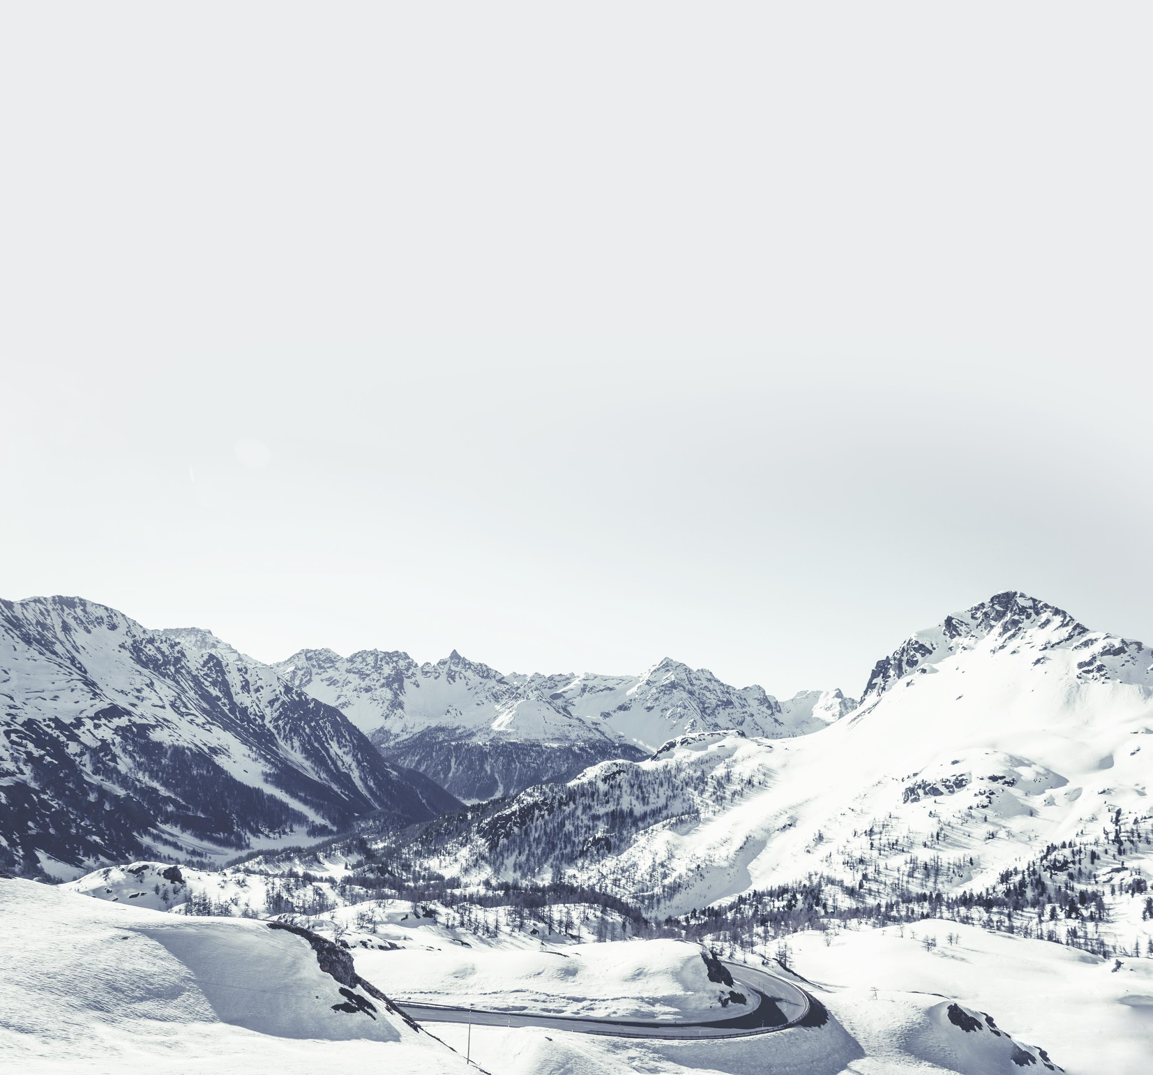
objectives
  To highlight the team’s behavior and communication and thus create better conditions for cooperation and effectiveness. To contribute to the continued development of the team by raising awareness and highlighting opportunities and possible challenges. To better understand the team’s communication styles. To create energy to continue the discussion and development of the team.
  Anything else you would like to achieve?

Slide 4
what is your 'why' as a team/group?
Notes:
Var står gruppen i vilket syfte de ska fylla i organisationen. Har de en klar vision om vad de ska uppnå? Vilket why har var och en av deltagarna i teamet/gruppen?

Slide 5
Content
introduction
team roles
team

Slide 6
Ethics, confidentiality and the role of the process consultant
Notes:
Processkonsulten är ansvarig för att säkerställa konfidentialitet och professionell sekretess i teamanalysen,
att skapa förutsättningar för självreflektion i teamet.
Det finns inga rätt eller fel beteenden och det grafiska resultatet visar inget ”facit”.

Slide 7
what is a team?

Slide 8


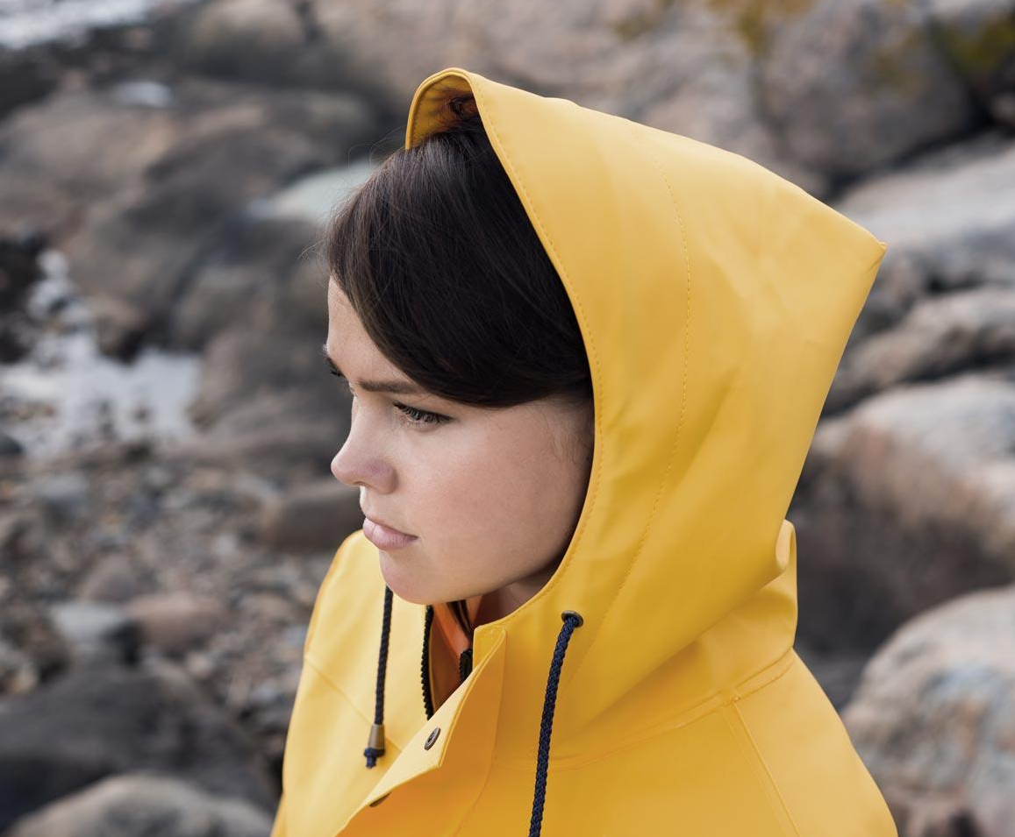
team
01 | working towards common goals
02 | have different roles
03 | are interdependent
04 | must work together to achieve results
05 | together create a whole that is larger than its components
are you a team?

Slide 9
in a team, balance is the crucial element. what is needed are not well-balanced individuals, but individuals who are harmoniously balanced in relation to each other.
Notes:
The team tool is a method of evaluating which team best suits the individual (when recruiting to teams), or within a team, which role the person in question might typically take on.
Individuals that are well balanced relative to each other (go to OH) refers to how important it is that those team roles represented in the team complement each other. Thus it is not so much the number of persons but rather the absence of one or more of the 8 roles that will weaken the efficiency of the team. Thus a successful team may well consist of 3-5 persons. According to Belbin, most people have primary and secondary roles (see OH no.12).

Slide 10
key competencies
Most individuals working in teams bring these key competencies:
Professional knowledge/specialist knowledge, qualifications and experience
Personal characteristics/behaviour
Notes:
It is important to distinguish these key competencies, as both can exert a decisive influence on the efficiency of the team. However, experience has shown that focusing on just one of the 2 competencies, e.g. professional/specialist knowledge and qualifications does not necessarily lead to a successful team. Point 1, however, is often the basis of an employment and wide experience indicates that this is also often the basis for selection to a team project.
Remember that MPA and the team role tool do not measure point 1. This tool allows you to examine competencies under point 2. The tool sets the stage for self-reflection, team-reflection and the development of the individual and the team.

Slide 11
what affects the team's behavior?
team role behavior
personality
role learning
values
intellectual ability
experiences and attitudes
relation to the outside world

Slide 12
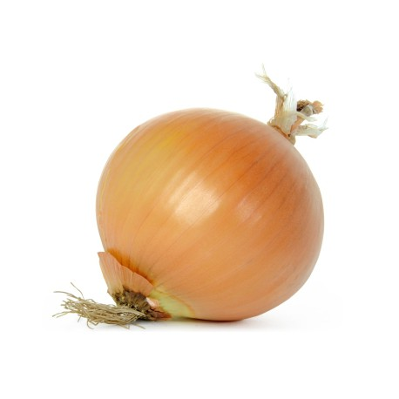
personality

Slide 13
efficient teams

Slide 14
characteristics of an effective team
Involved leadership
Positive atmosphere
Cooperation
Actively balanced participation
Appreciating differences
‘
Open conflict management
Clear
goals
Defined
Roles
Open and clear communication
Efficient decision-making processes
Notes:
Most organisations are subject to many and rapid change processes, which make great demands on the flexibility of individuals and teams if they are to be efficient and survive.
It would therefore be unrealistic to see how there could be a sustainable "recipe" for the efficient team. Instead, based on research and experience one can examine work methods and develop methods that are suited to the changed circumstances. E.g. today, teams are becoming less uniform as a result of changes in working patterns such as part time working, flexible working hours, working from home and cooperation across national borders, etc.
Michael West: As teams become more diverse in their composition and work functions, members must learn to observe and adapt to the changing circumstances - in order to be efficient this is a prerequisite of efficient team work.
Go to OH: The above model (from The Pfeiffer book and Successful Teambuilding Tools) is a model of the characteristics present in successful teams. This model was presented at the Introduction Course. The model is useful in fathoming your team and finding the areas where there may be aspects in need of clarification which are preventing the team functioning optimally. The boxes in the model have not been set up at random. The boxes at the bottom form the foundation of all the others and must be well established at the early stages of the team. Row 2 is also essential in the early stages and entirely depends on the basic foundations (the bottom row) being in place. Row 3 contains characteristics which provide job satisfaction and make it rewarding to be in the team. Experience has shown that the top box - participating leadership - is the only box that can be removed without disturbing the others. This does not mean that leadership and the type of leadership is without influence but that especially in the early stages of the team the leader is not a crucial factor. It can also mean that leadership can be passed around depending on the team's work assignments or the team's "development phases". The model is equally useful in motivating and clarifying how working with team roles, behavioural preferences and differences can contribute to raising team efficiency and cooperation. There are two boxes in the model highlighted in red. These indicate where emphasis is to be placed in the model when working with MPA and the team role model.

Slide 15
four dimensions of teamwork
 |  | Result orientation
 |  | High | Low
Social Well-being |  | Type 1: Fully functional team High result orientation Good social well-being Long viability | Type 2: Process-oriented, comfortable team Poor result orientation High social well-being Short viability
 |  | Type 3: Task-oriented, cold team High result orientation Means or poor social well-being Short viability | Type 4: Dysfunctional team Poor result orientation Poor social well-being Very low viability
High
Low
Notes:
When the consultant is to ensure motivation for the process and support for the use of the team tool (refer to points on Flip-over No. 5), it may be appropriate to clarify the relationship between the team members' behavioural preferences (= team's typical mode of operation) and team efficiency. Models are useful in this connection.
Re OH) Michael West constructs a practical, useful model for intra-team cooperation. The model can be used to characterise a specific team (the members can also participate in identifying themselves). His model illustrates 4 types of intra-team cooperation and is the most visible influence on the most important outcomes of team cooperation: efficiency in achieving goals, the members' sense of satisfaction and the team's viability.
Michael West proposes 3 main components for team efficiency:
"Task efficiency" is the degree to which the team succeeds in reaching its task-related objectives.
"Mental satisfaction" refers to the team members' sense of well-being, growth and development.
"Team viability" is the likelihood that the team will continue to work together and function efficiently.
Re: fully-functioning teams: open communication about objectives, procedures, duties and intrapersonal satisfaction. Wants the collaboration.
Re: cosy teams: often low satisfaction with the team from the rest of the organisation.
Re: dysfunctional teams: often much internal conflict among team members.
Re: The cold, efficient team: In this case, the members often want to conclude the team inspite of high "task efficiency".
Refer to the Introduction in Michael West’s book, which has an example of how to measure task and social reflexivity.
A short summary of Belbin's "strategies" for a winning team:
A coordinator as team manager
A wide range of intelligence
A wide range of roles
A distribution of member duties which are appropriate to their abilities
Belbin also experienced that less successful teams typically distributed work duties based on what the members had previously worked with without fully considering this.
All research in this area shows that one unforeseen factor (each small change in the group) can ruin an otherwise promising balance in the team:
One person loses interest
A member is absent
A redistribution of duties
A change in procedures
Etc.
It is Utopian to think that there is a guaranteed recipe for building an efficient, cooperative team. It is currently more the rule than the exception that workplace conditions are undergoing rapid change and development. This indicates that individuals, teams and organisations must be flexible if they are to be effective and persist. In order for a team to function efficiently, the members must actively focus on both their goals (the task), their working methods and the team's social interation. A well-functioning and efficient team is consciously aware that a team consists of members with a number of different emotional, social and task-related preferences/needs that the team as whole either is filling or counteracting.

Slide 16
exercise: reflection on the team
place the team in the "box" where it belongs (based on your own experience with the team).
what is the team most in need of right now?

Slide 17
team roles
There are 8 team roles in Master Person Analysis.
They're based on Meredith Belbin's team theories.
Most interchange is achieved if you combine many of the roles in a team collaboration because they complement each other.
You can match to these roles based on your answers in the questionnaire – you can match all roles in various degrees or just one to a very small degree.
Most recognition is normally in the primary and secondary team role, the roles you match most or second most, especially if these two are prominent compared to the others.
A tool for development in MPA

Slide 18
the purpose of the team roles
to focus on behavior in a team and be able to help the team improve and develop their collaboration by gaining a better understanding of each other and creating awareness.
focus on the cause of efficiency problems, conflicts, communication misses, etc.

Slide 19
eight team roles
Coordinator: Coordinates goals and resources. Utilizes the group's resources.
Initiator: Starts the group. Taking the lead. Focused on goals.
Toiler: Works sustainably and loyally in accordance with company goals. Put ideas into practice.
Resource investigator: Keeps in touch with outsiders and forwards information.
Ideas person: Quick with new ideas, extensive theoretical knowledge and overview. Independent.
Critic: Has a critical approach to suggestions. Thorough, careful.
Team worker: Focuses on internal collaboration within the team. Empathetic, diplomatic and understanding.
Accomplisher: Ensures that all details and procedures are completed. Careful.
definitions

Slide 20
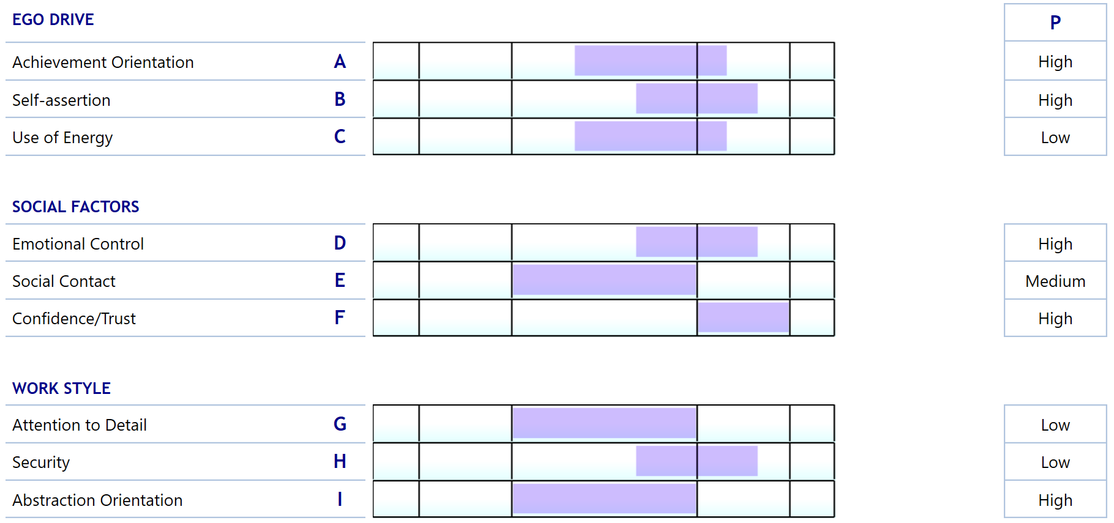
coordinator
The Coordinator controls in a non-dominant manner.
He/she summarizes and coordinates efforts, and thus
keeps the objective constantly in focus; stands out as
Being self-disciplined and stable, possessing an open
and unprejudiced approach to others that enables
him/her to identify and exploit valuable people and ideas; as group leader concentrates on exploiting all the group members' resources but may find it difficult to arrive at decisions where it is not possible to take all the group members' contributions into consideration.

Slide 21
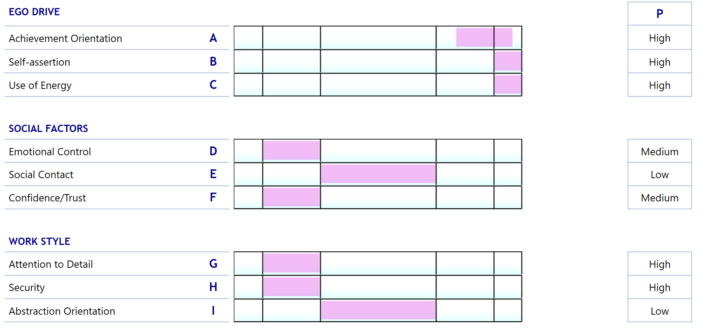
initiator
The Initiator acts as leader in a dominant manner. By making quick decisions and getting things going he/she will often be the one that ensures the group is in constant movement, preferably in the direction of the Initiator's own interests and objectives; maintains a firm grasp on the tasks in hand and works determinedly towards obtaining results; does not hesitate to express his/her opinions and as a result may provoke other group members; an enthusiastic group leader who gets the others behind him/her, but who finds it difficult to follow up, and work may be unstructured.

Slide 22
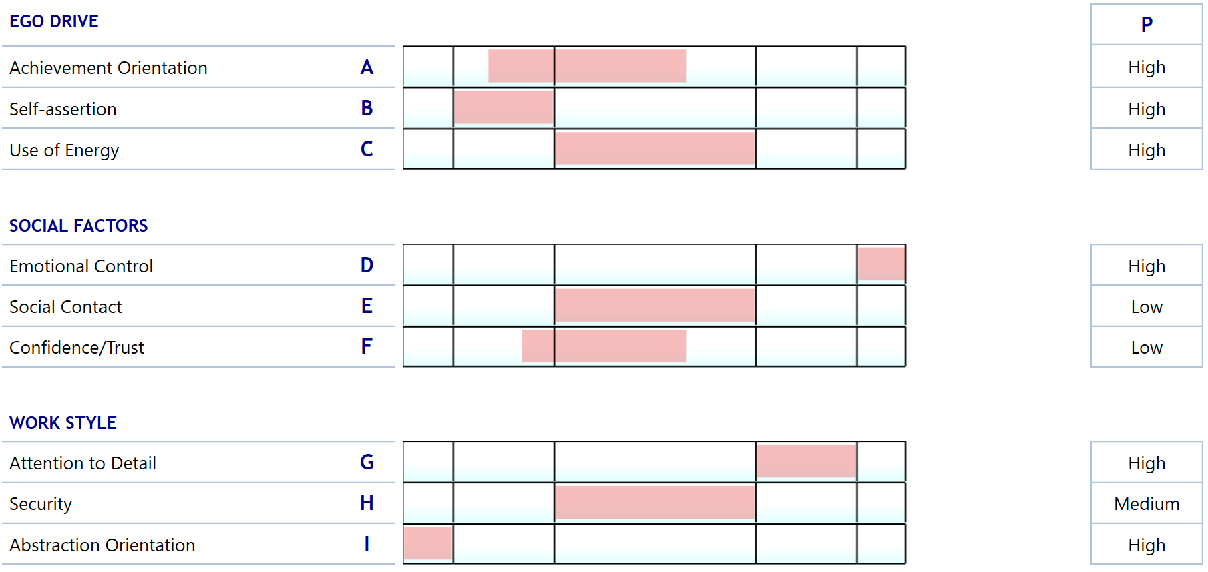
toiler
The typical Toiler identifies with the company's objectives and policies instead of going his/her own way; gets the job done by working in a self-disciplined and careful manner and with great staying power; carries out the tasks assigned and attaches great importance to practicability and ensures tasks are carried out thoroughly; puts adopted plans into practice systematically and efficiently; will as group leader conscientiously ensure
that the group complies with the guidelines and objectives established but may lack personal clout faced with the other members of the group.

Slide 23
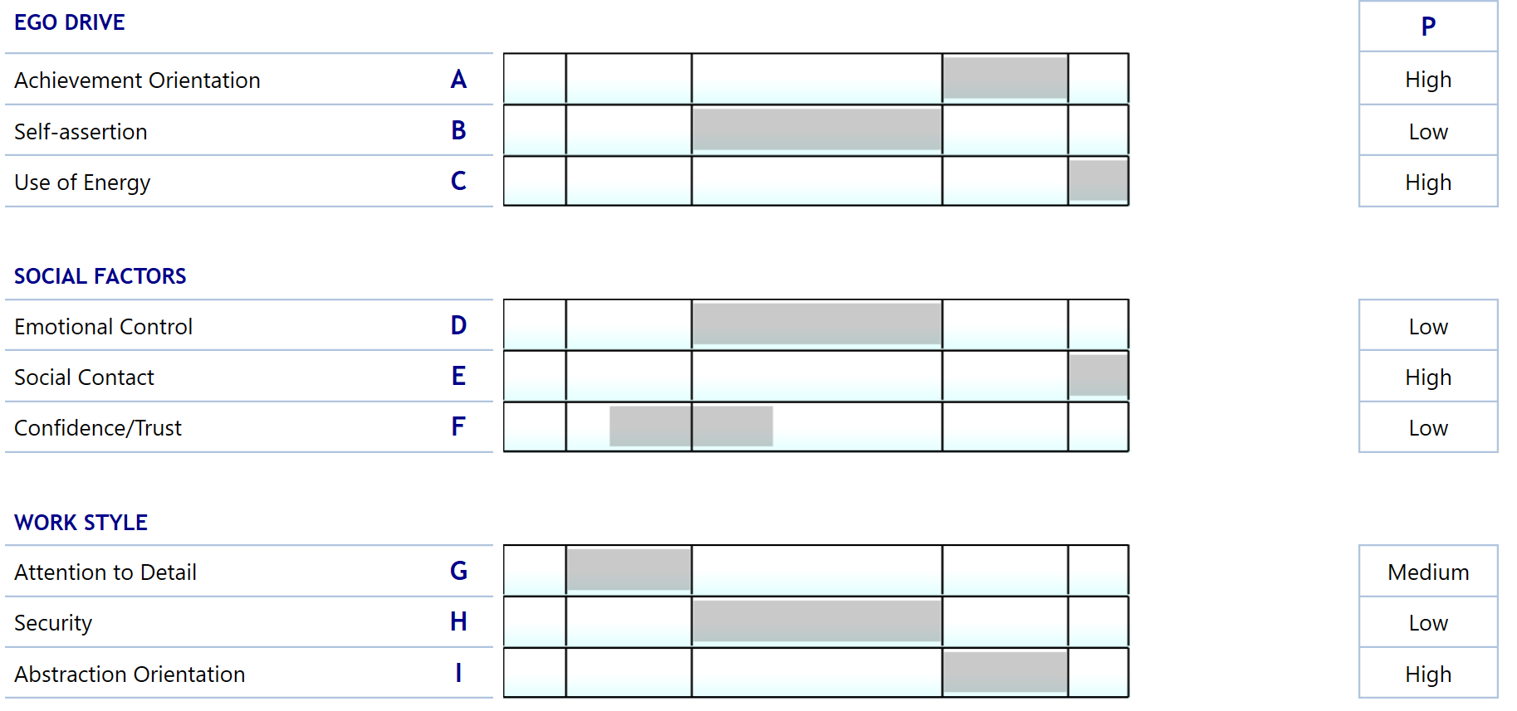
resource investigator
The Resource Investigator stands out as being energetic, extroverted and someone who reaches out to others; enjoys getting inspiration from other people's ideas as a jumping-off point for his/her own ideas. The Resource Investigator is well aware that some details may be important, and therefore exhibits a certain thoroughness when this is necessary; leads the group by listening and making decisions on the group’s proposals with regard to internal company and external factors; may find it difficult to bring tasks to completion, as new, relevant aspects which need to be taken account of, are constantly popping up.

Slide 24
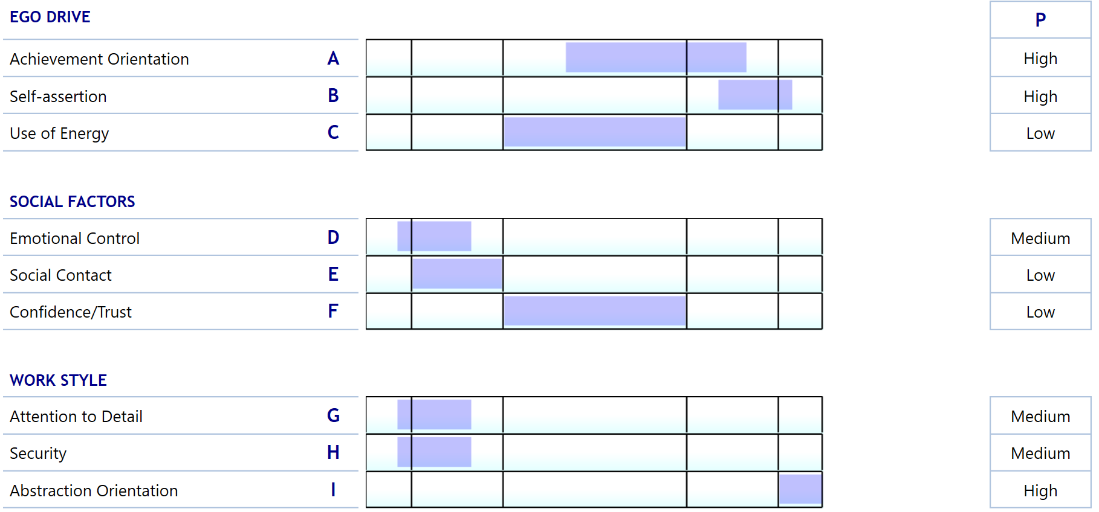
ideas person
The Ideas Person is the person in the group who makes the most marked contribution to constant development and change. The Ideas Person acts in a dominant manner but tends to keep to himself/herself - with the result that it may be difficult for the other members of the team to keep pace with the new ideas
and plans. The Ideas Person has a strong overall grasp and is happy to make quick decisions that create movement within the group; leads others by acting as a sparring partner when it comes to investigating possible alternatives; motivates group members to elaborate on the Ideas Person's ideas independently.

Slide 25
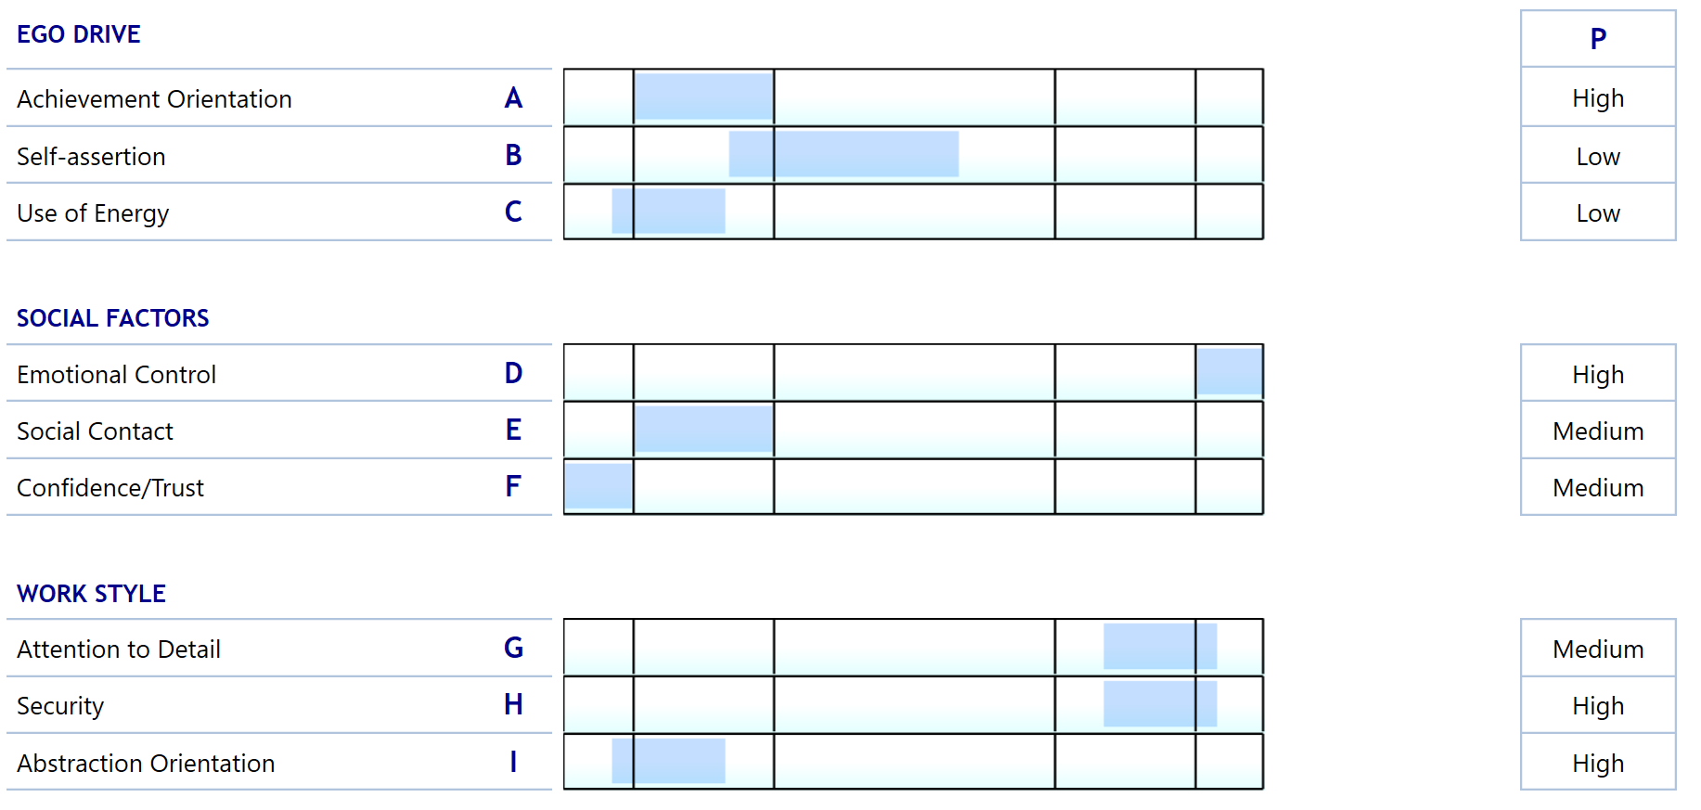
critic
The Critic is the group member most likely to make objective evaluations and sort out proposals produced based on the group's overall objectives without consideration of his/her own interests in the choice of task; works thoroughly and conscientiously and often questions the quality of the other group members' work as regards specific details and contingencies. As leader he/she attaches great importance to following up on projects implemented and thus ensuring their professional quality; may experience difficulties in motivating the group and getting it involved.

Slide 26
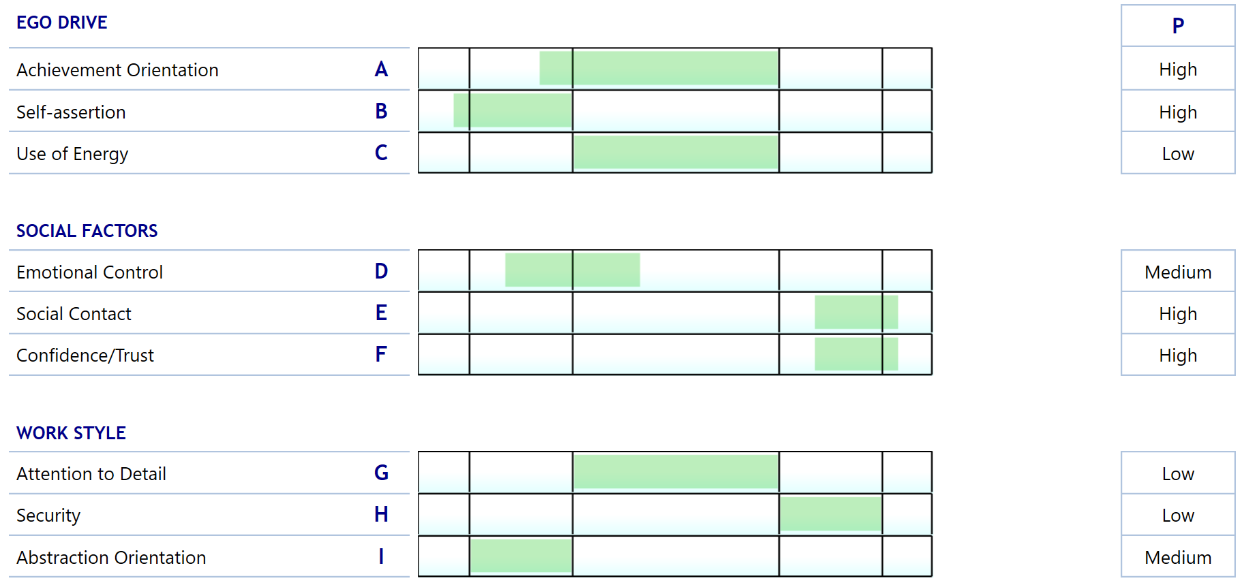
team worker
The great strength of the Team Worker is getting on with other people, thus contributing to strengthening the lines of communication within the group. The Team Worker tries to ensure that cooperation within the group is as smooth as possible by being extrovert without attempting to dominate or control, with the result that the Team Worker stands out as being a confidence-inspiring and sensitive person. As group leader the Team Worker achieves results through others by motivating employees towards making shared efforts; however, may have difficulty in accepting the necessity that the group leader must sometimes go ahead and take the lead without backing from the others.

Slide 27
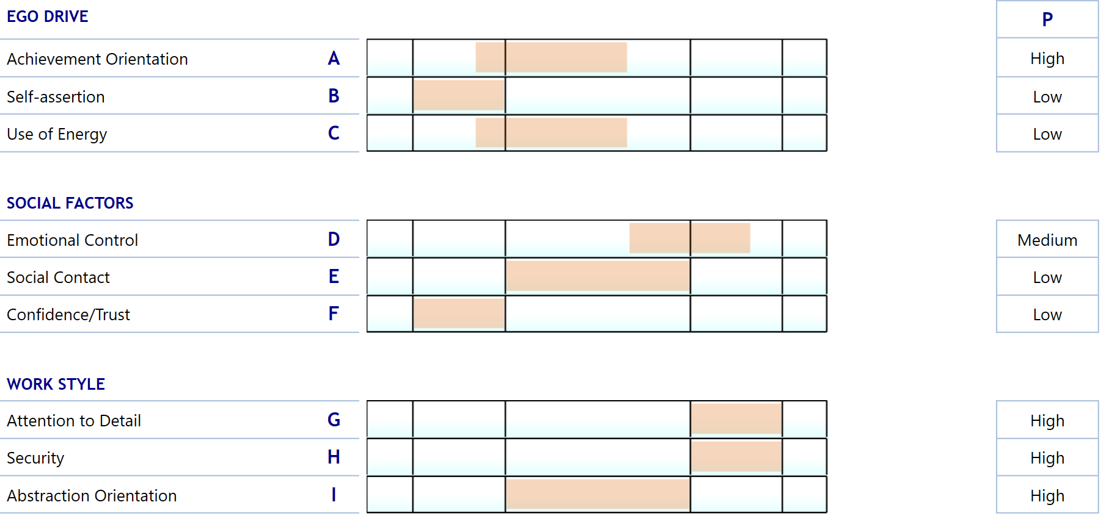
accomplisher
The Accomplisher is typically the person who prioritises the team's work assignments and ensures that all the details are attended to and that the quality is as it should be. Although the Accomplisher is not so likely to get things going, he/she is the guarantee that work that has already been started will also be completed; works conscientiously and is cautious when making decisions; checks the work. As group leader makes sure tasks are completed and thus maintains commitment within the group; may find it difficult to delegate work and accept new initiatives.

Slide 28
coordinator's strengths and pitfalls
Typical characteristics: controlled, calm, trusting, adaptable.
Contributes these strengths to the team: planning – coordinates and integrates the team's resources, focuses on the goals and maintains an overview under stressful conditions.
Less attentive to (permissible weaknesses): Disputes in the group, creative initiatives, making decisions without consensus in the team, can be perceived as dominant when coordinating.
Notes:
Finally, the course instructor sums up. Only 20 minutes are reserved (5 minutes per team role). Use OHs as needed to provide instruction and summarise. The OHs contain the system profiles, team role definitions and team role characteristics (total of 17 OHs).

Slide 29
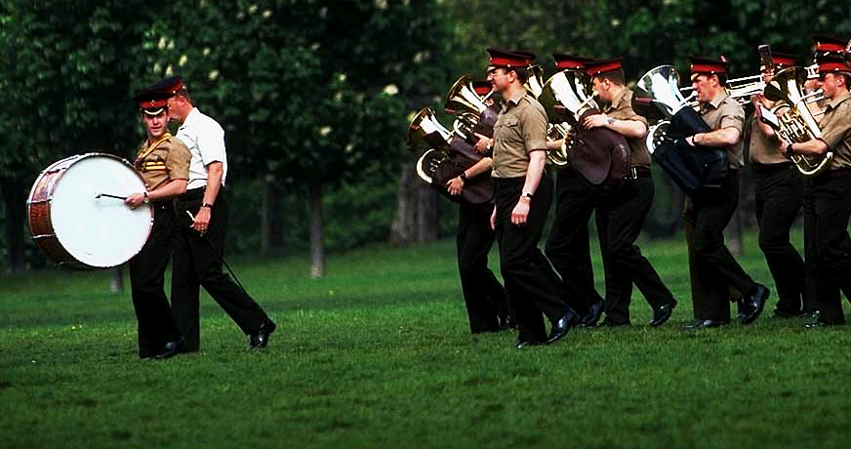
initiator’s strengths and pitfalls
Typical characteristics:
dynamic, extrovert, restless, controlling, dominant.
Contribute these strengths to the team:
enthusiasm, determined at resistance, goal-oriented, short decision-making processes.
Are less attentive to (permissible weaknesses): consider the ideas of others, show patience in detailed work, establish a strong foundation to make decisions from outside.
Notes:
Finally, the course instructor sums up. Only 20 minutes are reserved (5 minutes per team role). Use OHs as needed to provide instruction and summarise. The OHs contain the system profiles, team role definitions and team role characteristics (total of 17 OHs).

Slide 30
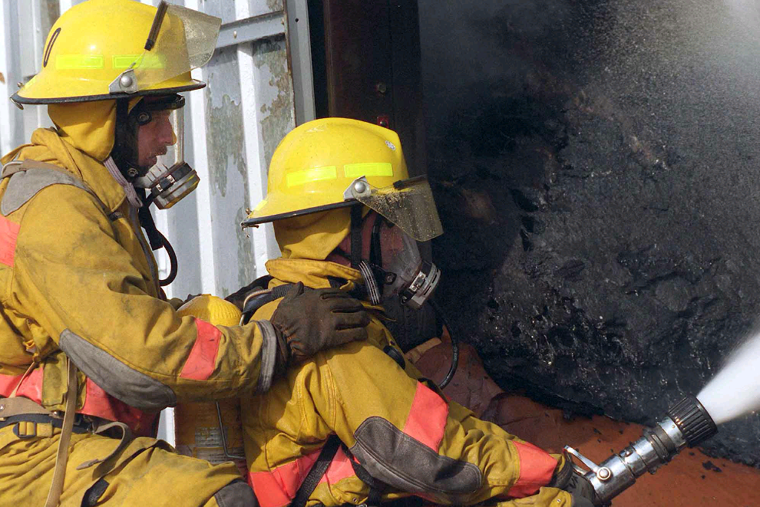
toiler’s strengths and pitfalls
Typical characteristics:
Careful, careful, self-disciplined, durable, practical.
Contributes these strengths to the team: launching ideas/plans, working sustainfully/carefully, maintaining a case-oriented approach, accuracy in the decision-making process.
Less attentive to (permissible weaknesses): Flexibility in the face of new ideas and proposals, show/react to the feelings of others, motivate others, take the initiative to implement new approaches.
Notes:
Finally, the course instructor sums up. Only 20 minutes are reserved (5 minutes per team role). Use OHs as needed to provide instruction and summarise. The OHs contain the system profiles, team role definitions and team role characteristics (total of 17 OHs).

Slide 31
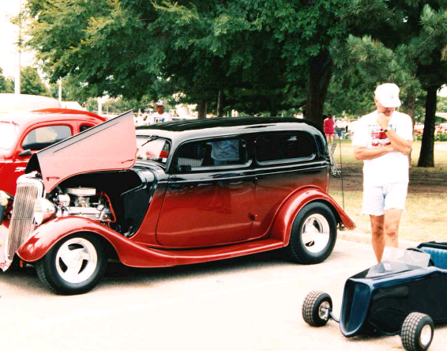
resource investigator's strengths and pitfalls
Typical characteristics:
Extrovert, energetic, inquisitive, enterprising.
Contribute these strengths to the team: explore/find new ideas, create new contacts, launch new tasks, delegate.
Are less attentive to (permissible weaknesses): complete tasks, retain interest in a case, the ability to work independently, focus the energy within the team.
Notes:
Finally, the course instructor sums up. Only 20 minutes are reserved (5 minutes per team role). Use OHs as needed to provide instruction and summarise. The OHs contain the system profiles, team role definitions and team role characteristics (total of 17 OHs).

Slide 32
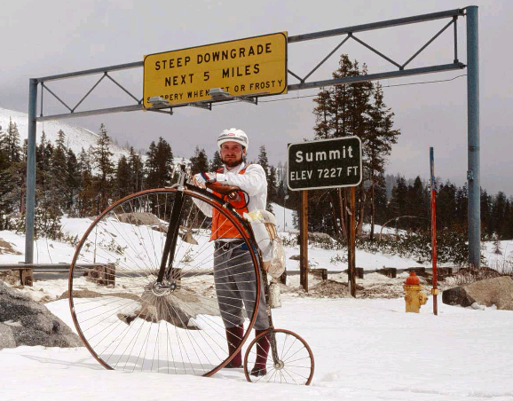
ideas person’s strengths and pitfalls
Typical characteristics:
Resourceful, development-oriented, individualist.
Contribute these strengths to the team:
creative and ingenious ideas/suggestions, movement in team development and working methods, has an abstract and theoretical approach, has an influence when he/she talks.
Pay less attention to (allowed weaknesses): launch ideas, involve others in ideas/plans, adapt to the team's working style, work with details.
Notes:
Finally, the course instructor sums up. Only 20 minutes are reserved (5 minutes per team role). Use OHs as needed to provide instruction and summarise. The OHs contain the system profiles, team role definitions and team role characteristics (total of 17 OHs).

Slide 33
critic's strengths and pitfalls
Typical characteristics:
analytical, cautious, critical, task-oriented.
Contribute these strengths to the team:
an objective/co-oriented approach to proposals/ideas, follows decisions made, perseverance in data resolution, argues objectively and with conviction.
Less attentive to (permissible weaknesses): get involved in the team's social well-being, show confidence in the efforts and suggestions of others, that his/her direct skepticism can be demotivating to others.
Notes:
Finally, the course instructor sums up. Only 20 minutes are reserved (5 minutes per team role). Use OHs as needed to provide instruction and summarise. The OHs contain the system profiles, team role definitions and team role characteristics (total of 17 OHs).

Slide 34
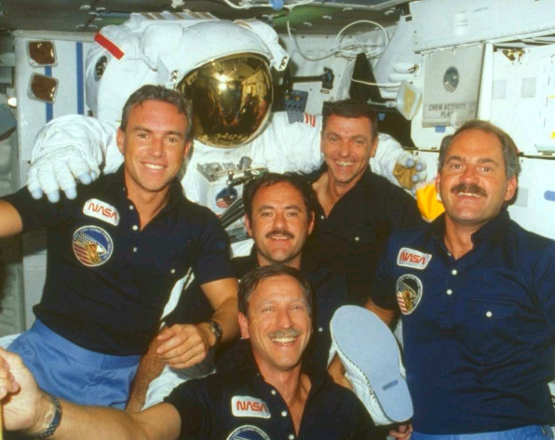
team worker’s strengths and pitfalls
Typical characteristics:
extrovert, tolerant, cooperative, caring.
Contribute these strengths to the team:
adapts to the team, works to establish a good working climate, creates contacts and communicates with the entire team, shows understanding of differences in the team.
Less attentive to (permissible weaknesses): dealing with conflicts, having a fact-based/critical approach to other people's proposals, taking criticism, coming up with independent proposals.
Notes:
Finally, the course instructor sums up. Only 20 minutes are reserved (5 minutes per team role). Use OHs as needed to provide instruction and summarise. The OHs contain the system profiles, team role definitions and team role characteristics (total of 17 OHs).

Slide 35
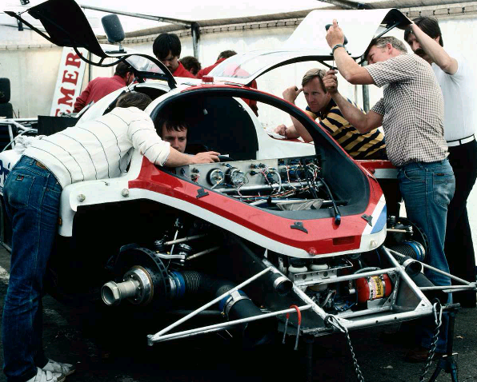
accomplisher’s strengths and pitfalls
Typical characteristics:
accurate, detailed, concentrated, solution-oriented.
Contributes these strengths to the team: ensures quality through detail focus, focus on completing, prioritizing/structuring time and effort in the team.
Pay less attention to (permissible weaknesses): keep a general overview, pay attention and show understanding of other people's reactions, come on/incorporate new initiatives.
Notes:
Finally, the course instructor sums up. Only 20 minutes are reserved (5 minutes per team role). Use OHs as needed to provide instruction and summarise. The OHs contain the system profiles, team role definitions and team role characteristics (total of 17 OHs).

Slide 36
team analysis
Notes:
Re: OH: The instructor illustrates a presentation of a Master Team Analysis based on the team participants' profiles. This centres on the headings from the list of how one presents the results of a MPA, which was introduced in 'Introduction to Master Team Analysis'.
The purpose of illustrating team feedback is to exemplify how the participant can use the team tool specifically in connection with team development. The illustration has three foci:
1) How can the consultant use the information in a Master Team Analysis to analyse a team in relation to behavioural preferences; typical modes of operation, similarities and differences among team members, team strengths and areas of development?
2) How can the consultant present his/her team analysis to a specific team?
3) How can the consultant use the analysis to formulate working hypotheses about the team?

Slide 37
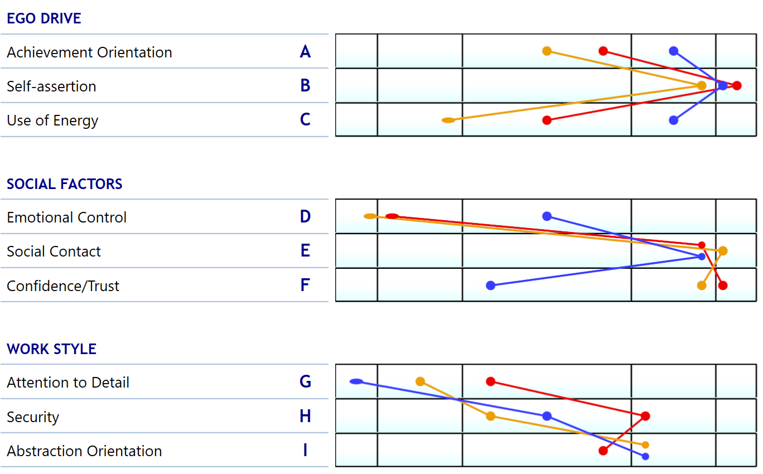
The team
Lower degree
Higher degree

Slide 38
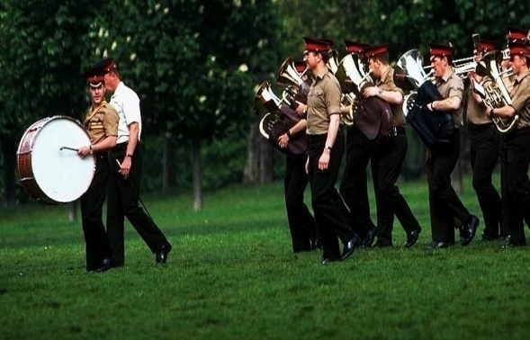
primary behavioral orientation in the team
1 coordinator
1 initiator
1 resource investigator
Notes:
Roller som saknas:
Kritikern,
Utföraren,
Färdiggöraren

Slide 39
Primary behavior orientation for the team
Composition:
1 coordinator, 1 initiator,
1 researcher
Primary features:
start-up, restlessness, energy, extroversion
Notes:
This OH makes the previous image of the team's primary orientation, focus, prioritisation, particular properties, strengths and potentials more concrete. What specifically is meant by the team members' primary preferred (as in this case) Team Roles: The Coordinator, The Initiator and The Ideas Person?
This OH is designed for the instructor to fill in using the specific composition of team role preferences in the course's "participant team" from your current group.
NB: Depending on the specific team role distribution and which team roles express the team's primary preferences, you may choose here to gather the team's primary preferences into one. This presumes, of course, that there is some similarity in the way the three roles operate and focus their energy. Thus all three roles, e.g. Coordinator, Ideas Person and Initiator, manifest a drive, a willingness to stand out and take control as well as orienting themselves towards solutions and goals. Likewise, there is obviously a difference among the three roles' preferences, for example in what each contributes to the process: coordination, initiatives or ideas. The reason we can recommend combining roles in your presentation is that there is some degree of resemblance, and it makes the presentation more manageable and thus understandable.
The consultant's primary task in each of these feedback reports/presentations is to create a balance between precision and comprehensibility. The presentation has to be as precise as possible while still being meaningful and understandable to the team members. This point and the difference between possible modes of presentation are treated in the Handout: Inspiration. How to structure a Team presentation. This was provided in the Introductory Course, but it may be worthwhile handing it out again now. Ask the participants if they are able to ask questions that expand on how they can group team roles in association with a team presentation in the upcoming exercise (Exercise: Master Team Analysis).

Slide 40
Additions; secondary orientation for the team
add-ons:
1 team worker, 1 accomplisher, and 1 initiator
Secondary features:
start-up, extroversion, accuracy
Notes:
This OH makes the previous image of the team's primary orientation, focus, prioritisation, particular properties, strengths and potentials more concrete. What specifically is meant by the team members' primary preferred (as in this case) Team Roles: The Coordinator, The Initiator and The Ideas Person?
This OH is designed for the instructor to fill in using the specific composition of team role preferences in the course's "participant team" from your current group.
NB: Depending on the specific team role distribution and which team roles express the team's primary preferences, you may choose here to gather the team's primary preferences into one. This presumes, of course, that there is some similarity in the way the three roles operate and focus their energy. Thus all three roles, e.g. Coordinator, Ideas Person and Initiator, manifest a drive, a willingness to stand out and take control as well as orienting themselves towards solutions and goals. Likewise, there is obviously a difference among the three roles' preferences, for example in what each contributes to the process: coordination, initiatives or ideas. The reason we can recommend combining roles in your presentation is that there is some degree of resemblance, and it makes the presentation more manageable and thus understandable.
The consultant's primary task in each of these feedback reports/presentations is to create a balance between precision and comprehensibility. The presentation has to be as precise as possible while still being meaningful and understandable to the team members. This point and the difference between possible modes of presentation are treated in the Handout: Inspiration. How to structure a Team presentation. This was provided in the Introductory Course, but it may be worthwhile handing it out again now. Ask the participants if they are able to ask questions that expand on how they can group team roles in association with a team presentation in the upcoming exercise (Exercise: Master Team Analysis).

Slide 41
Roles missing from your team
critic, toiler, ideas person
missing character traits:
critical approaches, execution, ideas
Notes:
This OH makes the previous image of the team's primary orientation, focus, prioritisation, particular properties, strengths and potentials more concrete. What specifically is meant by the team members' primary preferred (as in this case) Team Roles: The Coordinator, The Initiator and The Ideas Person?
This OH is designed for the instructor to fill in using the specific composition of team role preferences in the course's "participant team" from your current group.
NB: Depending on the specific team role distribution and which team roles express the team's primary preferences, you may choose here to gather the team's primary preferences into one. This presumes, of course, that there is some similarity in the way the three roles operate and focus their energy. Thus all three roles, e.g. Coordinator, Ideas Person and Initiator, manifest a drive, a willingness to stand out and take control as well as orienting themselves towards solutions and goals. Likewise, there is obviously a difference among the three roles' preferences, for example in what each contributes to the process: coordination, initiatives or ideas. The reason we can recommend combining roles in your presentation is that there is some degree of resemblance, and it makes the presentation more manageable and thus understandable.
The consultant's primary task in each of these feedback reports/presentations is to create a balance between precision and comprehensibility. The presentation has to be as precise as possible while still being meaningful and understandable to the team members. This point and the difference between possible modes of presentation are treated in the Handout: Inspiration. How to structure a Team presentation. This was provided in the Introductory Course, but it may be worthwhile handing it out again now. Ask the participants if they are able to ask questions that expand on how they can group team roles in association with a team presentation in the upcoming exercise (Exercise: Master Team Analysis).

Slide 42
hypotheses about the team

Slide 43
hypotheses about the team's strengths
Individuals have a strong need to be seen and heard. No one's perspective will be lost when everyone wants to be involved and influence.
Good holistic approach
The team is looking for contacts and is easily "marketing" themselves
The team has a very good energy in starting up and easily finds motivation for new things

Slide 44
hypotheses about the team's challenges
The team has difficulty completing tasks and loses motivation if there is too much management element.
The team doesn't want to devote itself to details.

Slide 45
exercise: relevance - consequence - action
Think independently: Is there relevance in the areas identified as the team's challenges?
Discuss jointly: Select one or two relevant areas where you discuss the consequences they may have.
Discuss together: What will be the next step? How are you going to jointly take responsibility for that?

Slide 46
communication

Slide 47
exercise - communication
What is important for achieving results?
What is the key to successful cooperation?
How do you want to communicate?

Slide 48
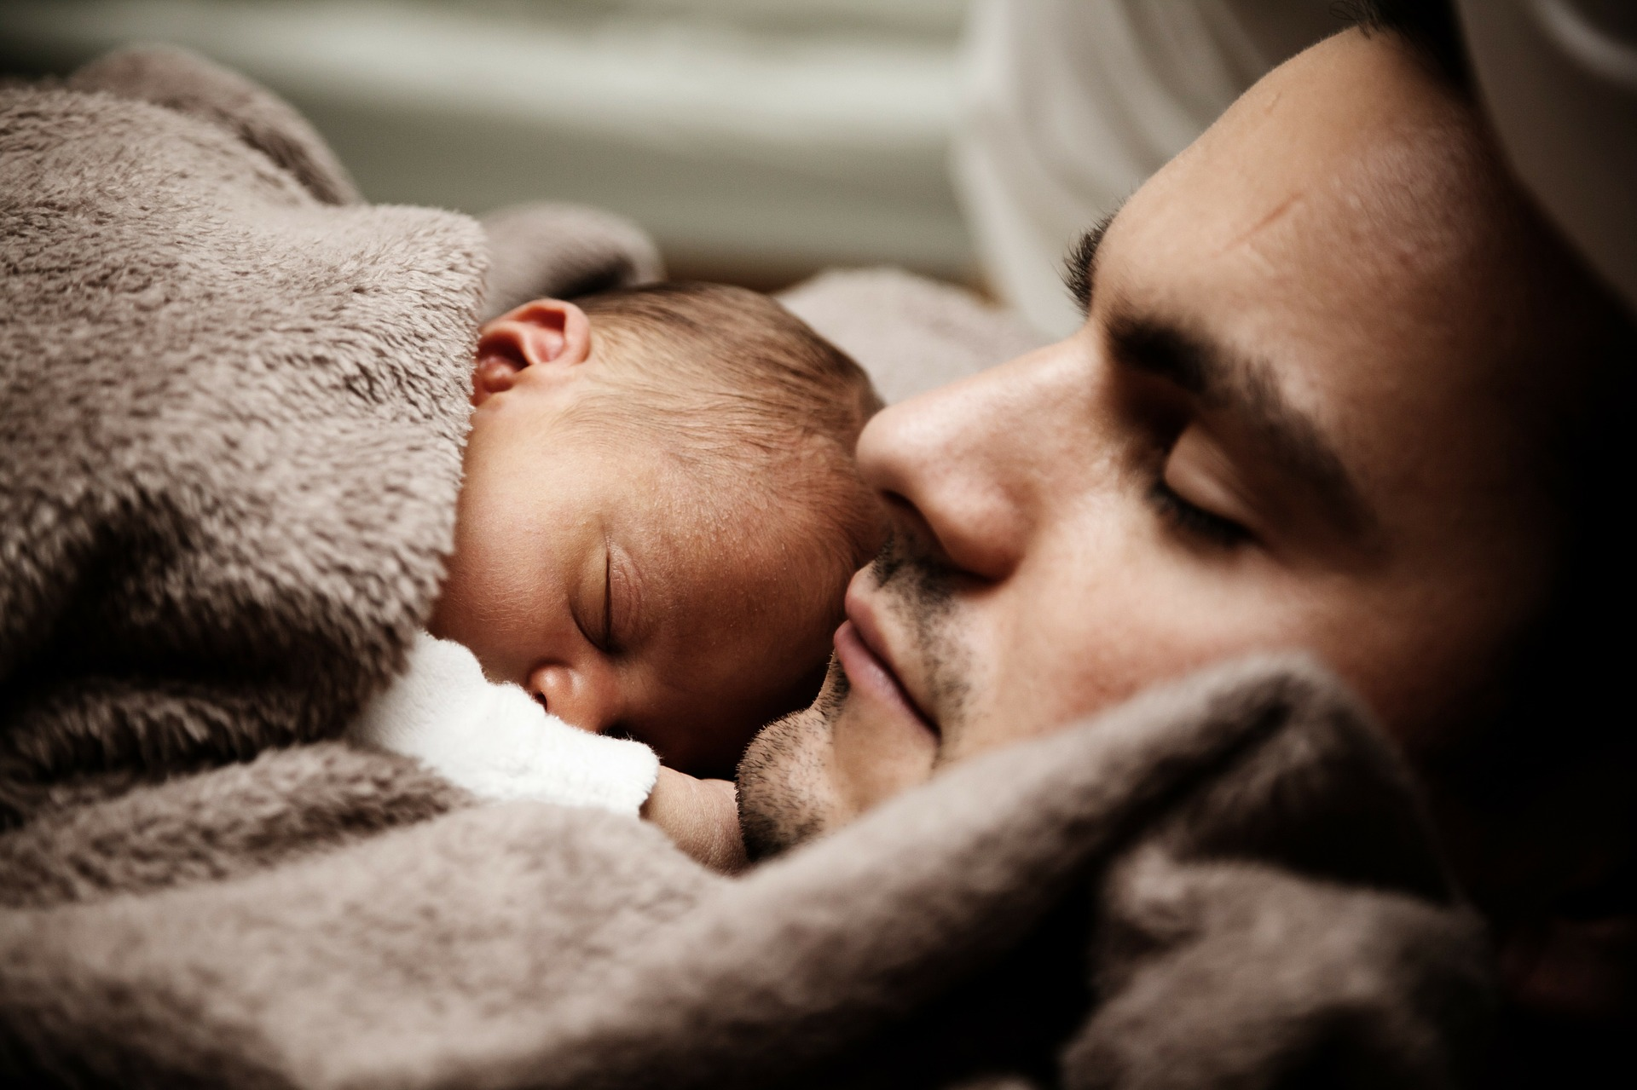
feedback

Slide 49
about giving feedback
Be concrete: observation of behavior. Alternatively, explain that it is a hypothesis.
Use I form: Take responsibility for your feedback. Let the recipient know that it's your perspective — not necessarily everyone else's.
Realistic: Is there anything that the focus person really can change?
Relevant: Is your feedback relevant in this context?
Don't forget to admit: There's always something you can think of that's positive.
Respect: Feedback is made for the recipient.

Slide 50
about getting feedback
The feedback is a gift that can not be exchanged!
Say thank you: someone has taken an interest in your development
You can opt out: sort out what you hear. Not everything needs to be constructive or useful.
You can ask for more, to understand it: without defending or explaining
Be open: It's possible that other people's perception of you hasn't been your intention – but that's how other people perceive you!
Use it to force improvements: not to stick to the old.
Take notes if you need to.

Slide 51
exercise: strengths and pitfalls
This exercise will help you become aware of your:
strengths
pitfalls
development areas
relationship with other people

Slide 52
exercise: strengths and pitfalls
strength
pitfall
Development measure
Divide into smaller groups.
In each group, one person begins to sit with his back to the others.
The others talk about that person's strengths and decide on a strength.
Use the strenghts and pitfalls handout and discuss your chosen strength
based on pitfall, and development measure. Fill in the paper.
The person does not need to have fallen into their pitfall for the strength to be relevant to talk about.
The person in question turns around reflecting on the chosen strength and what was discussed. The person gets "their" paper. Everyone in the group should have received feedback on strength as above.
A total of about 10 min/person.

Slide 53
strengths and pitfalls - example
STRENGTH:
Energetic
PITFALL:
Doting
DEVELOPMENT MEASURE:
Get others with you to get the most action
Notes:
AIM: to state that test used in Selection is a process that is more than just making the interview, and therefore where MPA is applied and supports the process will be part of this certification course.
When you first get the call e.g. from a line manager to find a new employee, it is crucial to find out what the expectancies are (aim and Criteria) for the future employee and what context this person will work within. Then you might be helped by earlier Assessments done e.g. using Criteria from earlier Assessments, looking into the team where the candidate will be part of, or even for internal candidates.
After defining Criteria and aim and finding the data you can re-use, it is time to make job adds, read through applications and CV’s and some might have Screening tools in place as well – alternatively and what is typically the case, the best applicants will be invited to fill in MPA and other tests and you will then have to make some analyses on the results and prepare yourself for a Muntlig återkoppling if you offer this. After a Muntlig återkoppling you will then have to sum up and evaluate the information gained from the process so far. You will then have to modify the assessment process if needed e.g. right candidates? Right Criteria ? When you find the process is ok, next thing will be to convey this information to the stakeholders – often a recruiting manager. This to help the stakeholders making the decisions.
Finally you will need to manage your data – some need to be deleted while some information might be added e.g. who was selected, how did the Criteria work for this Assessment etc.
We will train in the above mentioned steps…but first we will revisit your knowledge gained from the e-learning after getting to know each other at bit more….

Slide 54
Strength
Pitfall
Development measure

Slide 55
exercise - create action plan
Discuss the hypotheses about strengths/pitfalls. Do you agree?
What do you need to do as a team to avoid pitfalls?
What rules/guidelines should apply at future meetings for cooperation and communication to work?
Joint discussion: When and how do you follow up on following these rules/values?

Slide 56
thanks for today.
what is the most important thing you as a team created today?
when are you talking about this next time?

