Slide 1
team X
EASI team analysis workshop

Slide 2
purpose.
To place focus on the team’s behavior and communication style and thereby create better conditions to become an effective team that works in accordance with set goals. To contribute to further development in the team by raising awareness and highlighting opportunities and possible challenges. To better understand one's surroundings in order to be able to adapt communication to a greater extent. To create energy to continue the discussion and development of the team. What do you think?

Slide 3
what's your 'why’ as a team? where are you going?

Slide 4
content
introduction
the model
behaviors
the team

Slide 5
ethics, confidentiality and the role of the process consultant
Notes:
Processkonsulten är ansvarig för att säkerställa konfidentialitet och professionell sekretess i teamanalysen,
att skapa förutsättningar för självreflektion i teamet.
Det finns inga rätt eller fel beteenden och det grafiska resultatet visar inget ”facit”.

Slide 6
exercise - the core model

Slide 7
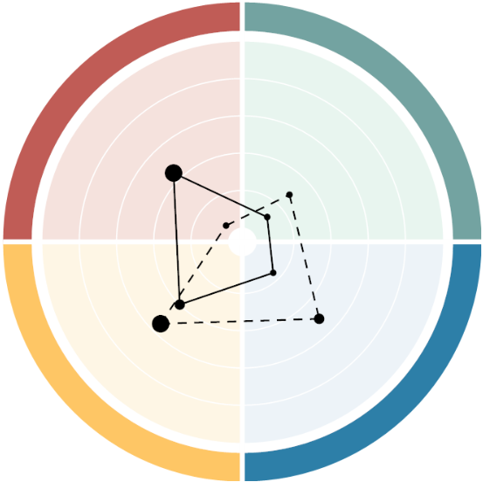
the four basic styles - behaviors
Exuberant Emotional Outgoing Influential Like to experiment Spontaneous
Sensitive Empathetic Welcoming Harmony-seeking Patient Seeking cohesion
E
S
Controlling Result-oriented Effective in decision-making Pragmatic Direct Impatient
Deliberate Systematic Conscientiuos Rational Critical Formal
I
A

Slide 8
what is a team?

Slide 9
team
01 | working towards common goals
02 | has different roles
03 | are interdependent
04 | must work together to achieve results
05 | together create a whole greater than its constituents are you a team?

Slide 10
EASI provides knowledge of
01 | typical behaviors
02 | strengths and pitfalls
03 | communication and communication style
04 | motivation
05 | development opportunities

Slide 11
communication.

Slide 12
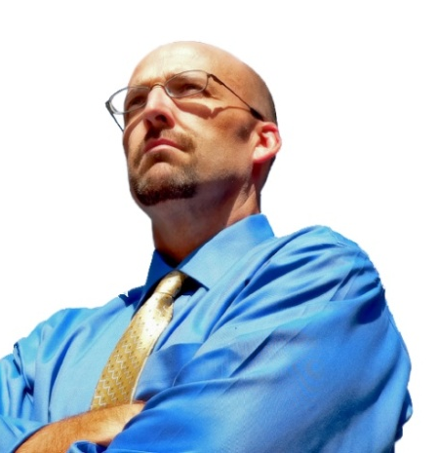
Associations to 'training'
implementer
enthusiast
analyst
supporter
E
A
New targets!
New network!
I
S
New inspiration!
New knowledge!
Notes:
Words can be given many different meanings and associations. They are dyed by our behavioural style and our experiences. For example, "education" can mean:

Slide 13
the four basic styles
Person
enthusiast
supporter
Control
Participating
implementer
analyst
Task

Slide 14
what are we talking about?
E
S
Feelings
Values
Personal experience
Cohesion
Recognition
Empathy
Possibilities
Exuberance
News value
Excitement
Prestige
Overall view
I
A
Quality
Safety
Plan
Structure
Logic
Facts
Results
Independence
Success
Efficiency
No-nonsense

Slide 15
we cannot NON-communicate
When describing emotions and attitudes, the following applies: 7 % of the message is conveyed through the words said.
38% of the message is conveyed in the way the words are said. 55% of the message is conveyed through facial expressions. Albert Mehrabian, 1981/2009
What we say
How we say it

Slide 16
how do we say things?
E
S
Open
Acknowledging
Lively
Animated
Curious
Informal
Pleasant
Welcoming
Attentive
Patient
Accepting
Calm and present
I
A
Involved
Focused
Shows self-confidence
Quick and exact
Direct
Persuasive
Low-key
Formal
Well-prepared
Interested
Calm

Slide 17
the four basic styles
Person
Enthusiast
Supporter
Control
Participating
Implementer
Analyst
Task

Slide 18
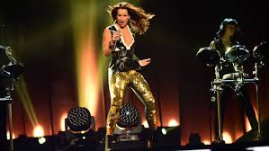
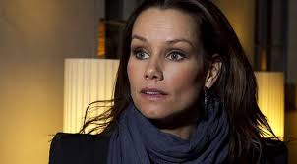
adapted behavior
Notes:
Now, of course, we have taken very clear examples and it can sometimes be difficult to see clearly which group you belong to. This may be because one is not so clear in one's expression, but it can also be because the person's primary and secondary behavior is so close to each other. It may also be that the person knows about their behavior and chooses to tone it down for some reason. As in this case,

Slide 19
practice - communication
what is important to achieve results? what is the key to successful cooperation? how do you want to communicate?

Slide 20
strengths and pitfalls

Slide 21
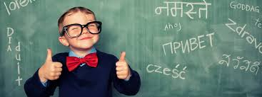
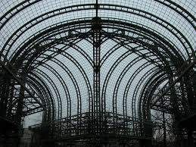
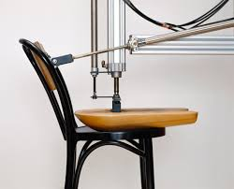
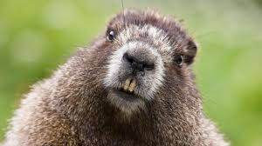
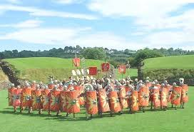
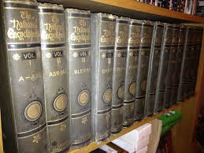
analyst
strengths
Notes:
Perfectionists, ensuring high-quality work
Provide structure and method to their own and group work
Make rational and carefully considered decisions
Search for logical solutions to problem
Evaluate and reality-check ideas and new initiatives
Hard-working, persevering and very conscientious
Use well-documented solutions and methods.

Slide 22
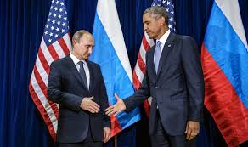
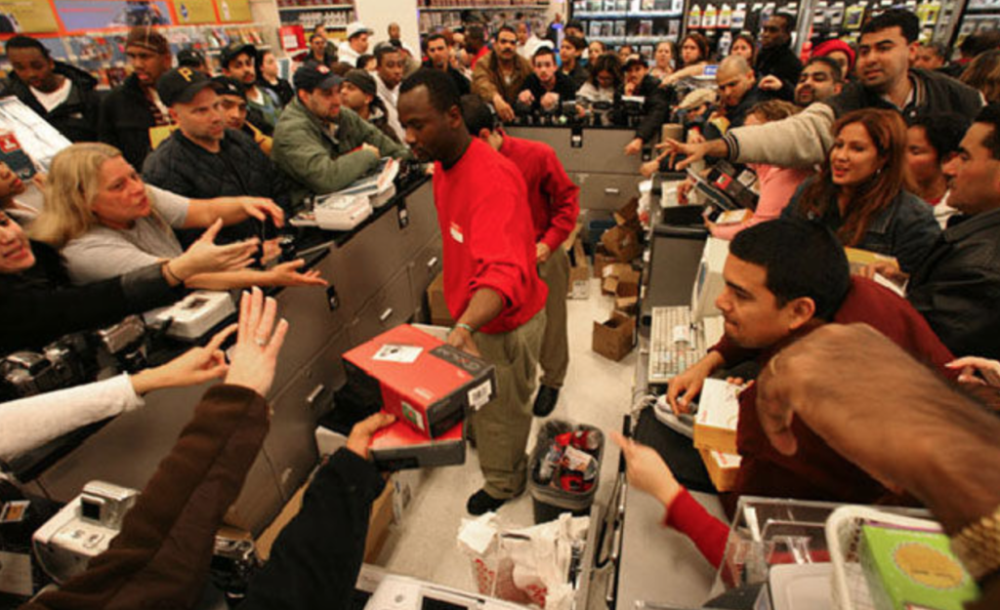
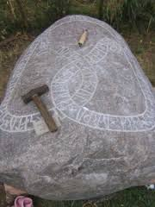
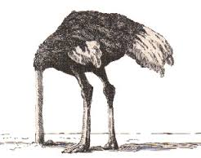
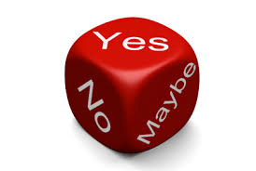
analyst
pitfalls
Notes:
Work slowly and push deadlines
Experience great difficulty tolerating and dealing with chaos
Are indecisive and hesitant
Have difficulty with dilemmas, political decisions or other problems which lack a clear-cut logic or objective truth.
Block the development of new ideas that they do not immediately consider to be realistic
Are not good at creating a relaxed social atmosphere, as they prefer to stay serious and formal
Seldom embrace change and consequently remain stuck in the past.

Slide 23
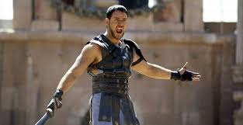
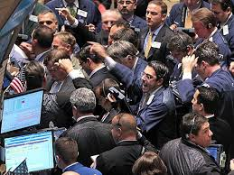
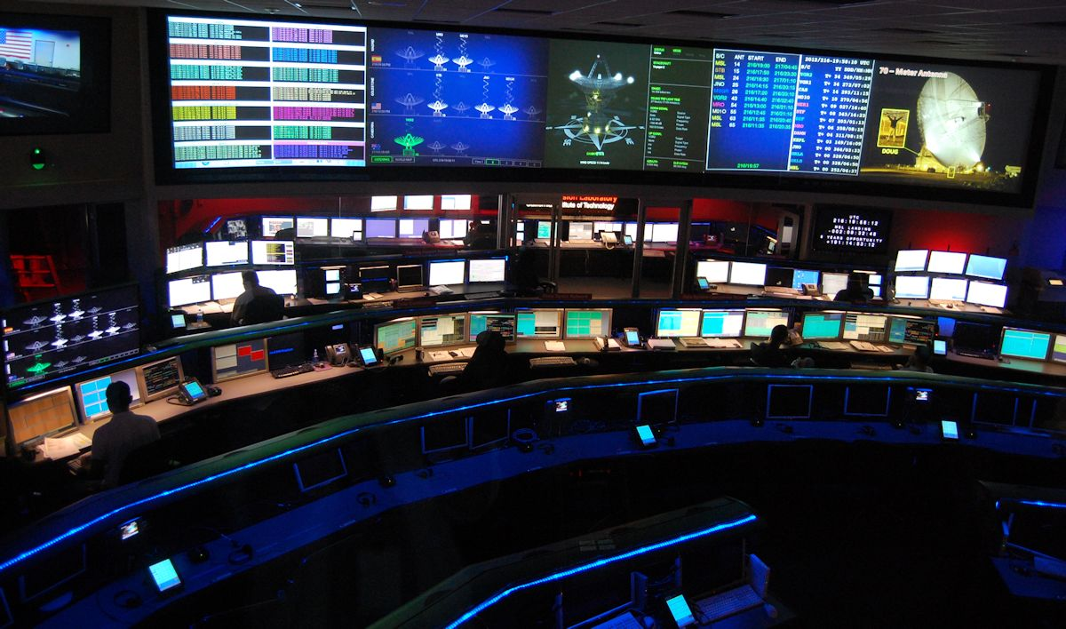
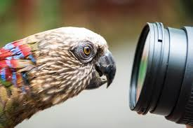
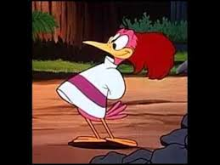
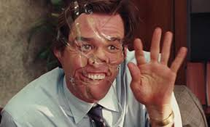
enthusiast strengths
Notes:
Have their own unique impact on decisions and discussions.
Infect everyone else with their enthusiasm.
Good at talking to everyone
Very energetic
Make rapid decisions
Are good at getting the big picture.
Very curious and like to experiment.
Easily navigate through chaotic situations that require improvisation or the adoption of new approaches.

Slide 24
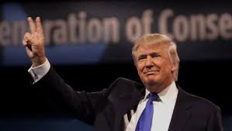
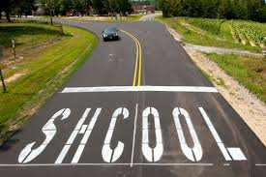
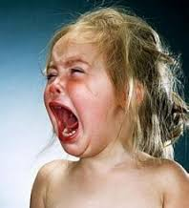
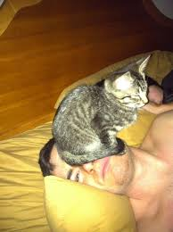
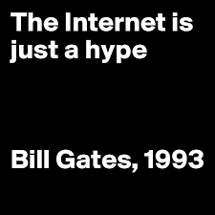
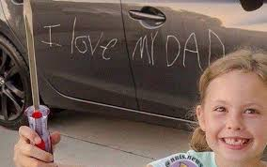
enthusiast pitfalls
Notes:
Impetuous and steamroll anyone in their path.
React emotionally to disappointments and criticism which has a negative effect on the mood of the team.
Superficial in their contact with others.
Become impatient and restless.
Make decisions that are not fully substantiated by facts.
Overlook important details.
Fail to appreciate solutions that previously have been shown to work.
Lack a methodical approach to task completion

Slide 25
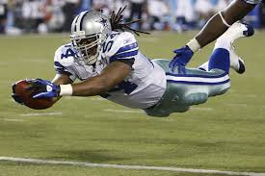
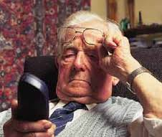
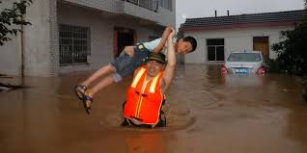
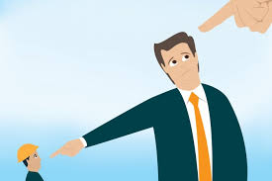
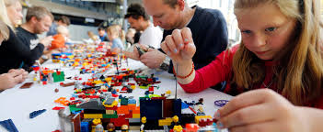
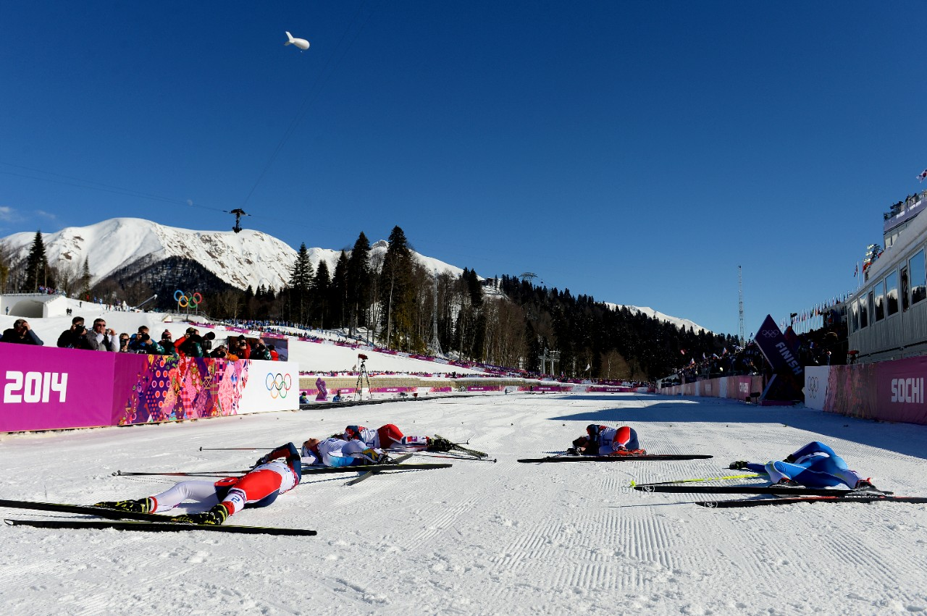
implementer strengths
Notes:
Like to get to the point in a matter-of-fact way, without fearing conflict
Decisive and energetic
Convert theory into purposeful solutions and implement them.
Like to work independently
Keep a clear focus on objectives, achievement and efficiency.
Rapidly gain control of new situations; and quickly start to organise and plan new tasks.
Good at delegating tasks of a routine or detailed nature – and following them up.
Go to great lengths to win competitions.

Slide 26
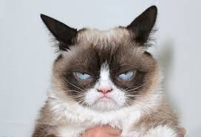
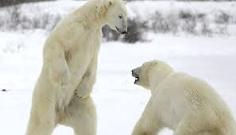
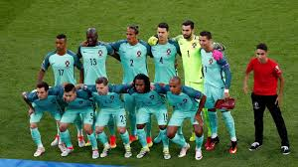
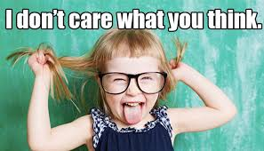
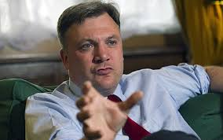
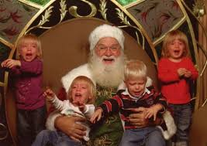
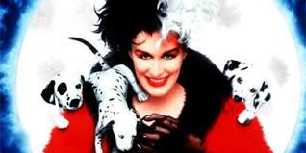
implementer pitfalls
Notes:
Appear reserved and cynical
Fail to make sure that everyone feels committed and involved in their decisions
Become restless if they are not immediately able to see a specific purpose to things
Do not pay attention to what others are motivated to do
Make colleagues who try to live up to their ambitious expectations disheartened and unmotivated
Do not make sure that other people understand and accept proposals for solutions
Push impatiently to see results, even though the responsibility for task completion has been delegated to someone else
When competing with others they often replace the common agenda with their own agenda

Slide 27
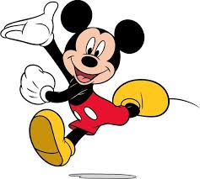
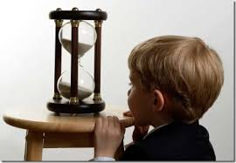
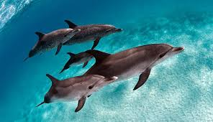
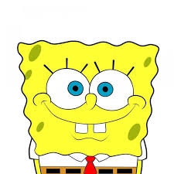
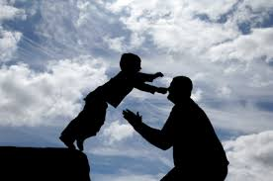
supporter strengths
Notes:
Friendly and pleasant
Help and support others and happy to sacrifice themselves for the sake of the group
Take everyone’s opinion into consideration and seek consensus
Sensitive. Quickly sense other people’s thoughts, attitudes and feelings
Patient. Contribute to peace and reflection in the group
Make others feel that their opinions are heard, thereby making them feel important
Show their trust and faith in others, which brings out the best in them

Slide 28
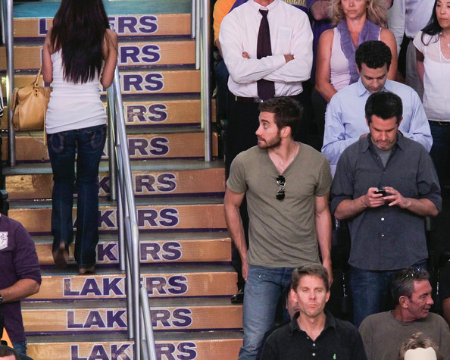
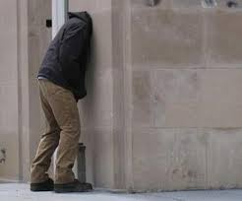
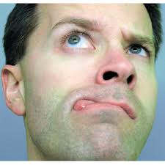
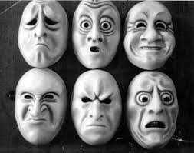
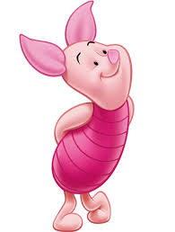
supporter pitfalls
Notes:
Make an anonymous impression
Forget their own needs in their eagerness to help others and end up overwhelmed
Delay decisions because they want everyone to be in complete agreement
Become inefficient as they are easily affected by other people’s bad moods, or by a negative atmosphere in the group
Lose focus on the progress of task completion
Withhold information if it is disagreeable to pass on
Appear naive in their faith in other people’s good and honest intentions

Slide 29
example: team behavior
Person
4
0
Control
Participating
3
1
Task

Slide 30
example: team motivation
Person
3
0
Control
Participating
3
2
Task

Slide 31
Example: Spread and diversity of team behavior

Slide 32
example analysis.
The group's emphasis in EASI is on the steering-oriented side (7 out of 8). Despite a strong majority of primary roles on the steering side, there is a medium diversity in the group, as many have good coverage in other types. There is every reason to believe that there can be good efficiency and cooperation in the group with attention to where strengths and pitfalls lie. It is important to try to find an action plan aimed at finding synergies that outweighs any under-representation of behaviours and communication styles needed to succeed in their joint work.
what does the composition look like?

Slide 33
examples: hypotheses.
Happy to take the lead and thrive in a governing position. Is determined. Creates results. Solves tasks and drives the work forward. Can make tough decisions without much emotional impact. Are relatively stress-resistant and thrive at a hectic pace.
team strengths

Slide 34
examples: hypotheses.
Might have a hard time getting along. May find it difficult to take in other people's opinions and listen actively. May have a hard time cooperating. Can be perceived as demanding. May be difficult to obtain, busy and/or inaccessible People close to the team may find it difficult to take their place and make their voice heard. Important information may thus be lost.
team pitfalls

Slide 35
feedback

Slide 36
about giving feedback
Be concrete – observation of behavior. Alternatively: Explain that it is a hypothesis. Use me form: Take responsibility for your feedback. Let the recipient know that's your perspective — not necessarily everyone else's. Realistic: Is there something that the focus person really has the opportunity to change?
Relevant: Is your feedback relevant in this context?
Don't forget to admit: There's always something you can think of that's positive. Be respectful: Feedback is given for the recipient's sake.

Slide 37
about getting feedback
The feedback is a gift that cannot be exchanged! Say thank you... (someone has taken an interest in your development) You can opt out... (sort out what you're told yourself. Not everything has to be constructive or useful). You can ask more, to understand it... (without defending or explaining)
Be open: It's possible that other people's perception of you hasn't been your intention - but that's how other people perceive you! Use it to force improvements — not to cling to the old. Take notes if you need to.

Slide 38
EASI Model - Strengths and Pitfalls
The Strengths and Pitfalls model helps you become aware of: Your strengths Your pitfalls Your development points Your relationships with other people
Strength
Pitfall
Development action

Slide 39
EASI Model - Strengths and Pitfalls
STRENGTH:
Energetic
PITFALL:
Numbing
DEVELOPMENT ACTION:
Get others with you to get the greatest possible action

Slide 40
Exercise: strengths and pitfalls
Strength
Pitfall
Development action
Divide into smaller groups. In each group, one person begins to sit with their backs
to the others. The others talk about that person's strengths
and decide one of the discussed strengths. Use the handout Strengths and pitfalls and discuss your chosen strength based on pitfalls, and development point. Fill out the paper. The person does not need to have fallen into their pitfall for the strength to be relevant to talk about. The person in question turns to reflect on the chosen strength and what was discussed. The person receives "their" paper. Everyone in the group should have received feedback on a strength as described above.
Estimated time: 10 min/person.

Slide 41
strengths and pitfalls - examples
STRENGTH: Energetic
PITFALL: Numbing
DEVELOPMENT ACTION: Get others with you to get the greatest possible action
Example: EASI model strengths and pitfalls

Slide 42
Exercise: strengths and pitfalls
Schedule for:
Strength
Pitfall
Development point

Slide 43
exercise - creating action plan
Discuss your approach to the hypotheses about strengths/pitfalls. What do you need to do as a team to avoid pitfalls? What rules/guidelines should apply at upcoming meetings for cooperation and communication to work? Joint discussion: When and how do you follow up that you follow these rules/values?

Slide 44
thanks for today.
what is the most important thing you as a team have created today? when will you talk about this next time?

